Slide 1
Analysis and Visualization Approaches to Assess UDU Capability
Presented at MBSW 2015
19 May 2015
Jeff Hofer, Adam Rauk

Slide 2
Outline
Background and Motivation
ASTM E2810
Linking development results to Process Validation and Routine testing
Bayesian analysis
Visualization tool
Conclusions

Slide 3
Motivation
USP 905 is a standard that must be met whenever a product is tested … it is not a release test
Increasing expectations to use ASTM E2810 (or other approach) to demonstrate ability to meet USP 905
ASTM E2810 provides requirements that, if met, for the specific sample size tested provide a specified level of confidence that the USP 905 test would be met at least a specified percentage of the time if tested in the future

Slide 4
Example OC Curves for ASTM plans and USP test from recent ISPE team publication
Demonstration of Conservativeness
True
These OC curves change based on the true batch mean

Slide 5
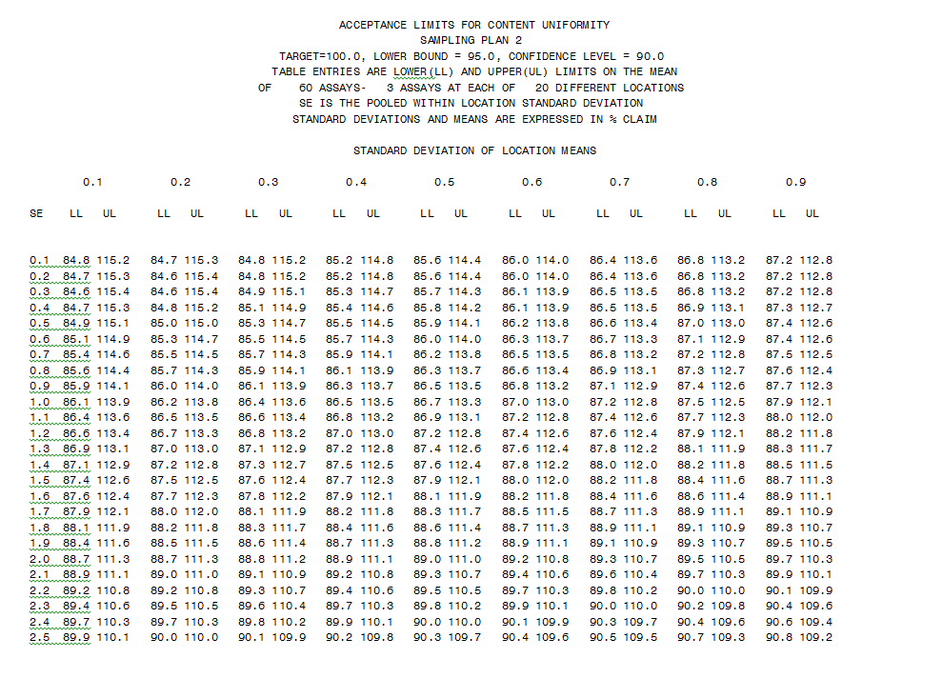
Example ASTM E2810 Acceptance Table
Acceptance Ranges
This table changes based on the sample plan and confidence/coverage

Slide 6
Question
How can one concisely and clearly summarize a product’s capability to meet complex criteria, such as that of ASTM E2810, from multiple Stage 1 (i.e., development) studies?

Slide 7
Challenge
Create a way to summarize development UDU study data that
Includes individual studies and provides an overall summary for a given product
Enables more informed risk assessments as a product moves from development into process validation and routine manufacture
Allows for comparison between products, platforms, and scales
Is readily understandable/interpretable

Slide 8
Desired Attributes
KISS
Seamlessly adjust for studies of varying size
Visualize the amount of uncertainty in the results
Leverage prior knowledge where appropriate
Apply Bayesian methods to estimate credible intervals for variability estimates
Some estimates using traditional random effects resulted in poor estimates. Bayesian methods provide significantly improved estimation in these cases.
Determine reasonable priors to use for variability estimates

Slide 9
Factors Impacting the Ability of a Batch to Pass the Different UDU Criteria
Batch Mean
Location to Location Variability
Within Location Variability
Note
Weight variability, concentration variability, and assay variability are not explicitly called out but they contribute to the above elements

Slide 10
Monte Carlo Simulation to Obtain 95% Limit Contours
Properties Varied
True batch mean
True location to location standard deviation
True within location standard deviation
Estimates
Probability of passing the various criteria
USP 905
ASTM 50/95 30 locations x 2 samples per location when there was either 0% or 90% of the total variance due to location to location (example Process Validation, Stage 2)
ASTM 50/80 10/30 (example Routine Release, Stage 3)
Summarize
Show contours of constant 95% probability of passing a given criteria on a plot of within location versus between location variability

Slide 11
Example OC Curves when μ=100

Slide 12
95% Pass Contours for Mean=100

Slide 13
95% Limit Contours for Passing USP, Example Process Validation (50/95)*, and Example Routine Release (50/80)*
Plots were created displaying the contours with 95% probability of meeting the specific criteria for different combinations of
True Batch Mean (96, 97, 98, 99, 100)
True Between Location Standard Deviation
True Within Location Standard Deviation
Contours become more restrictive as the true mean deviates from 100%
When showing multiple batches on same plot, show the contours corresponding to the worst case mean
*ASTM E2810

Slide 14
Working with Product Data

Slide 15
Product Data
Data are obtained for batches
Dosage units are obtained from multiple locations across the batch
At least two dosage units are tested from some locations
Bayesian analysis is performed to estimate the between and within location variability and associated credible limits

Slide 16
Bayesian Analysis
Bayesian statistical methods used to estimate the within and between standard deviations and 90% credible intervals (provides upper 95% credible limit)
Can incorporate prior belief and realistic constraints
Relatively non-informative priors utilized
Within location SD is Uniform(0.001,10)
Between location SD is Uniform(0.001,10)
Batch mean comes from a Normal(100,SD=10)
The actual data is utilized along with the prior to obtain a posterior distribution for the parameters

Slide 17
Summarizing Analysis Results
Plot the point estimates (medians) and the upper 95% credible limits for the posterior distributions of the between and within location standard deviations for individual studies/batches

Slide 18
95% Pass Contours for Mean=100 & Credible Intervals for Line Segment Creation
Upper 95% Credible Limit
Median Estimate
Upper 95% Credible Limit

Slide 19
Summarizing Analysis Results
If line lies inclusively within the contours, we have high (95%) confidence that true within and between location standard deviations are small enough for the batch mean that the corresponding criteria can be met 95% of the time
If point estimates fall directly on contour, we have 50% confidence that we could meet the corresponding criteria 95% of the time

Slide 20
Quality Statements
When the line endpoint lies inclusively within the contours, there is >95% probability that the true standard deviation is small enough for the batch mean that the corresponding criteria can be met 95% of the time
When a point estimate falls directly on the line, there is a 50% probability that the corresponding criteria will be met 95% of the time

Slide 21
Example – Plot of Contours for 95% Pass Percentage for Different Criteria using Worst Case Batch Mean versus 95% Credible Limits for Between and Within Location Variability

Slide 22
Example 2 – Plot of Contours for 95% Pass Percentage for Different Criteria using Worst Case Batch Mean versus 95% Credible Limits for Between and Within Location Variability

Slide 23
Conclusion
There is a desire to have a criteria that ensures that one would meet the USP 905 requirements a high percentage of the time
ASTM E2810 provides such criteria
Bayesian methods provide an excellent way to summarize development content uniformity data
Bayesian analysis results can be visualized to demonstrate a product’s capability to meet the USP and ASTM requirements
Such a product capability evaluation is useful for assessing risk as a product transitions from development to the manufacturing stages of process validation (Stage 2) and eventually routine release (Stage 3)

Slide 24
Backup Slides

Slide 25
Example OC Curves when μ=100

