Slide 1
Referral Network Visualization
Rubin Wei, Ph.D.
Eli Lilly and Company
Notes:
wei_rubin@lillly.com
https://www.linkedin.com/in/rubinwei

Slide 2
Background
We are launching a new drug ABC.
Drug ABC treats disease XYZ.
The XYZ market is relatively small.
The XYZ market is highly concentrated
The top 10% physicians treat about half of the market.
It is critical to focus on these key physicians.

Slide 3
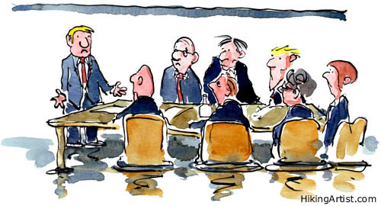
Start
Who influences whom?
Who do the specialists listen to?
Are there referral patterns that we should know about?
Who are the thought leaders?
Do you mean nationally or regionally?

Slide 4
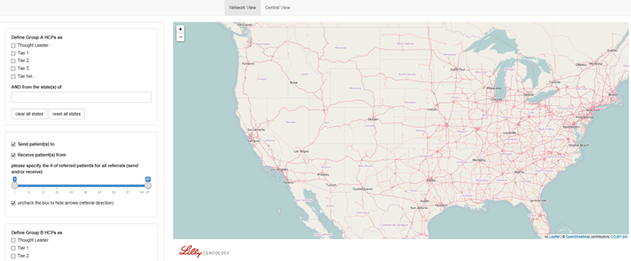
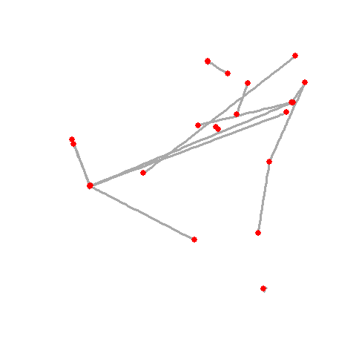
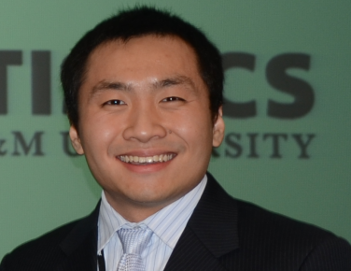
Development Process
Rubin Wei

Slide 5
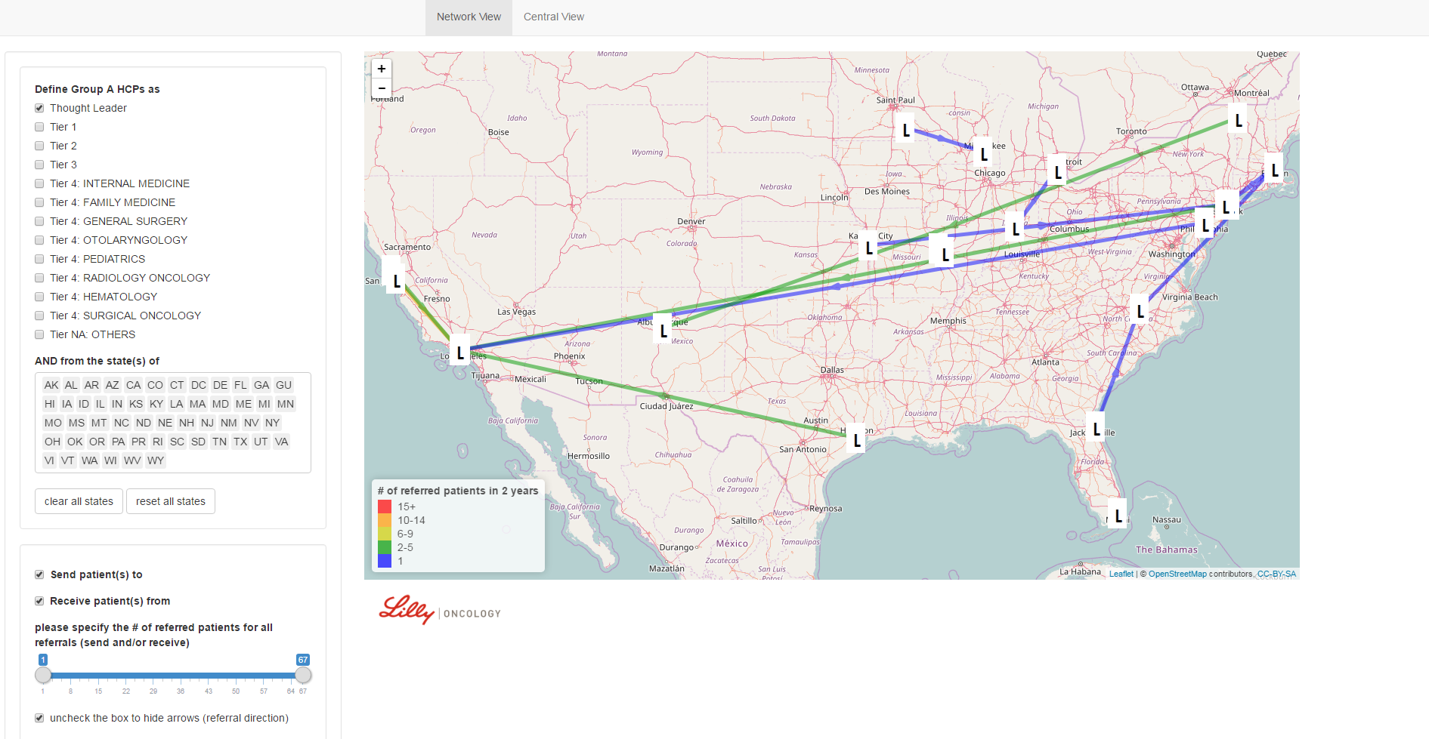
Referral Network Visualization Tool

Slide 6
Business Questions
Q1: What are the referral patterns among Thought Leaders?
Q2: Who are the top level influencers and where did all the referrals initiate and end? Can I visualize their level of referrals, geographies and tiers (patient volume)?
Q3: If a regional leader is selected as a peer-to-peer program speaker, who should be invited as the audience?

Slide 7
Network View

Slide 8
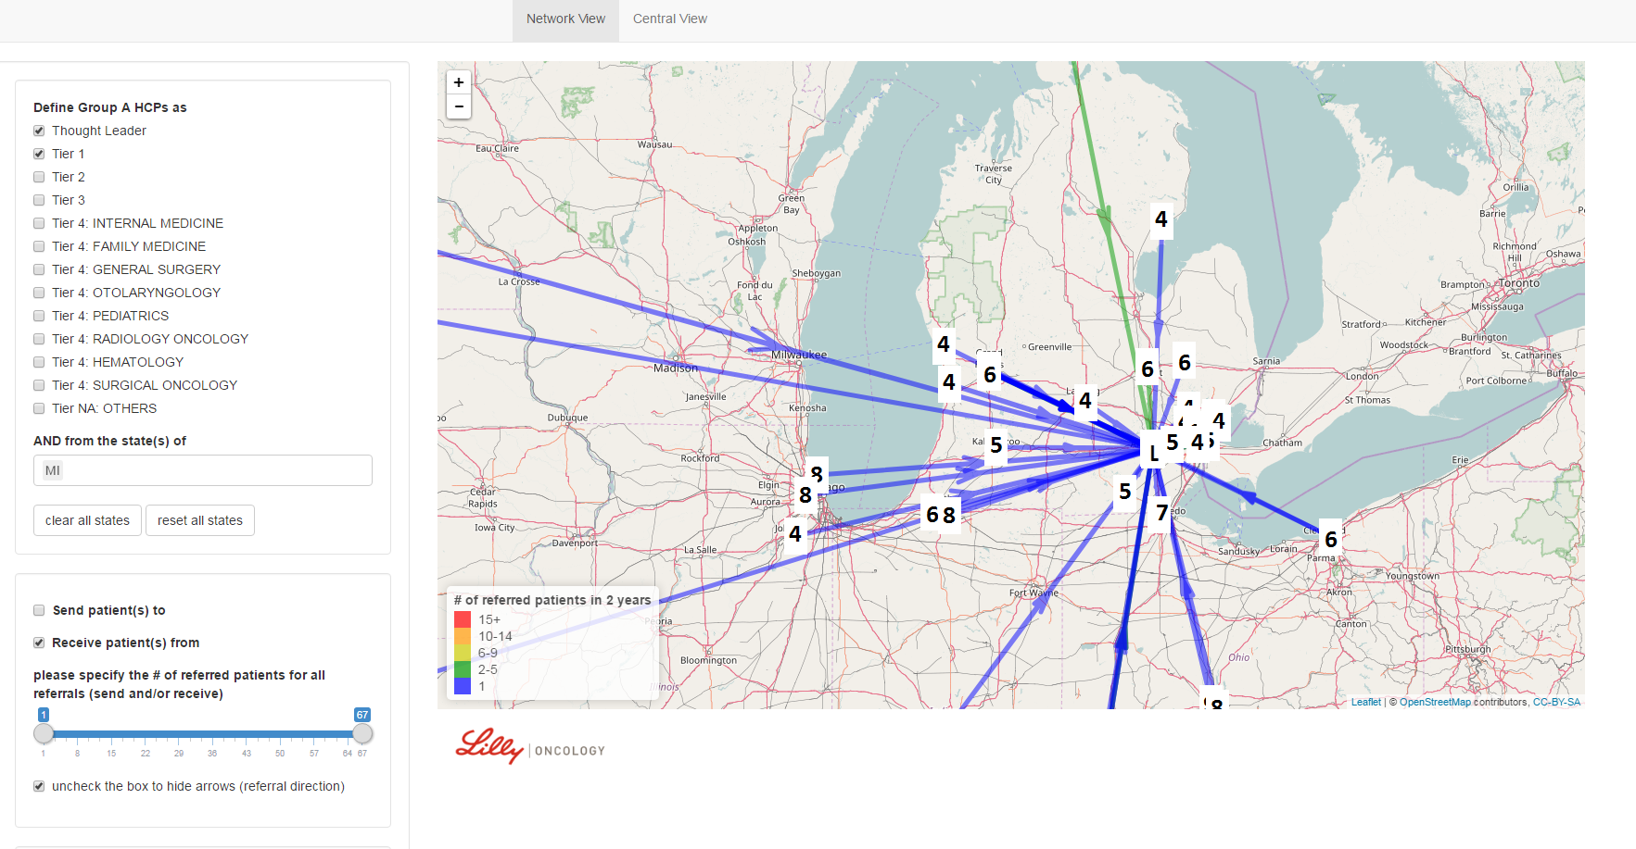
Network View

Slide 9
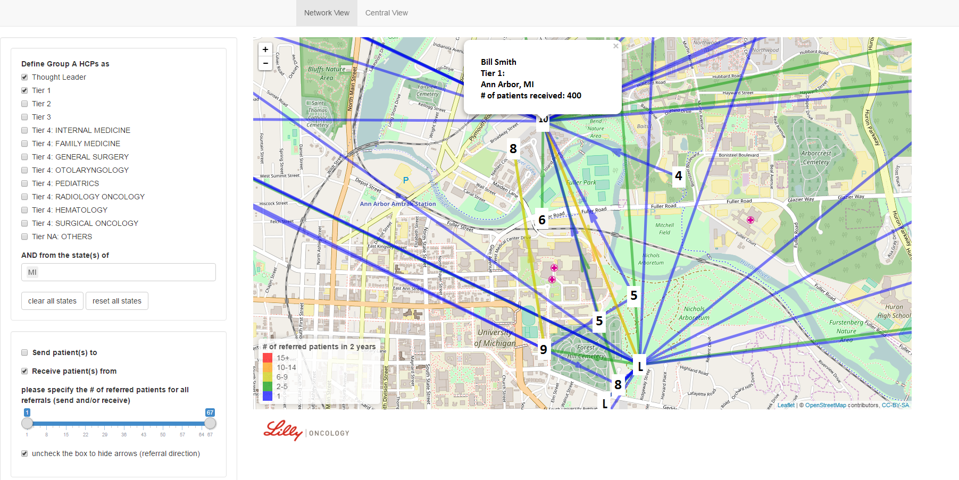
Network View

Slide 10
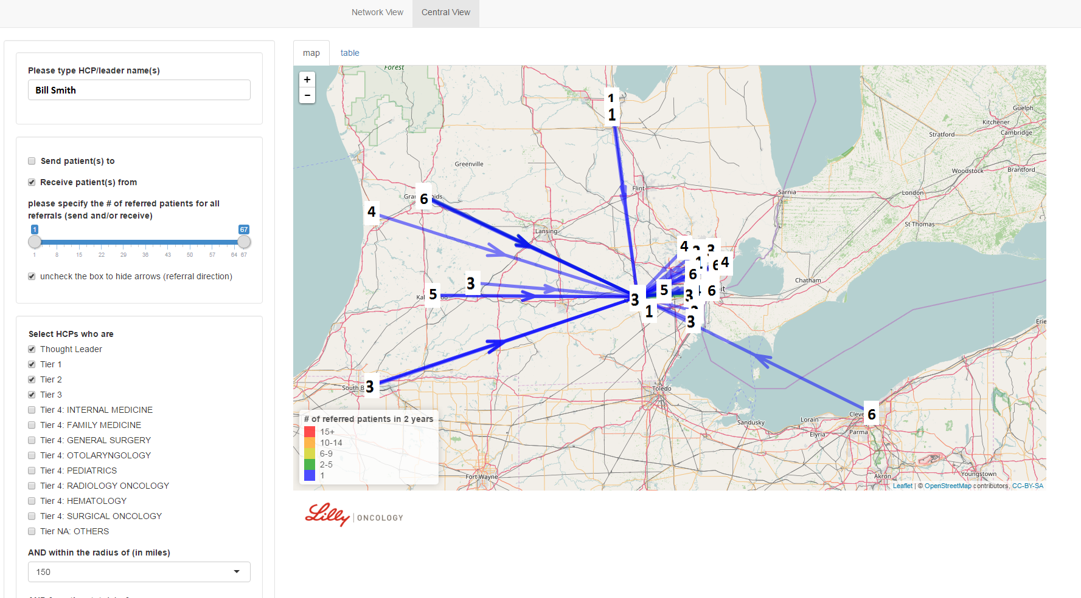
Central View: Map

Slide 11
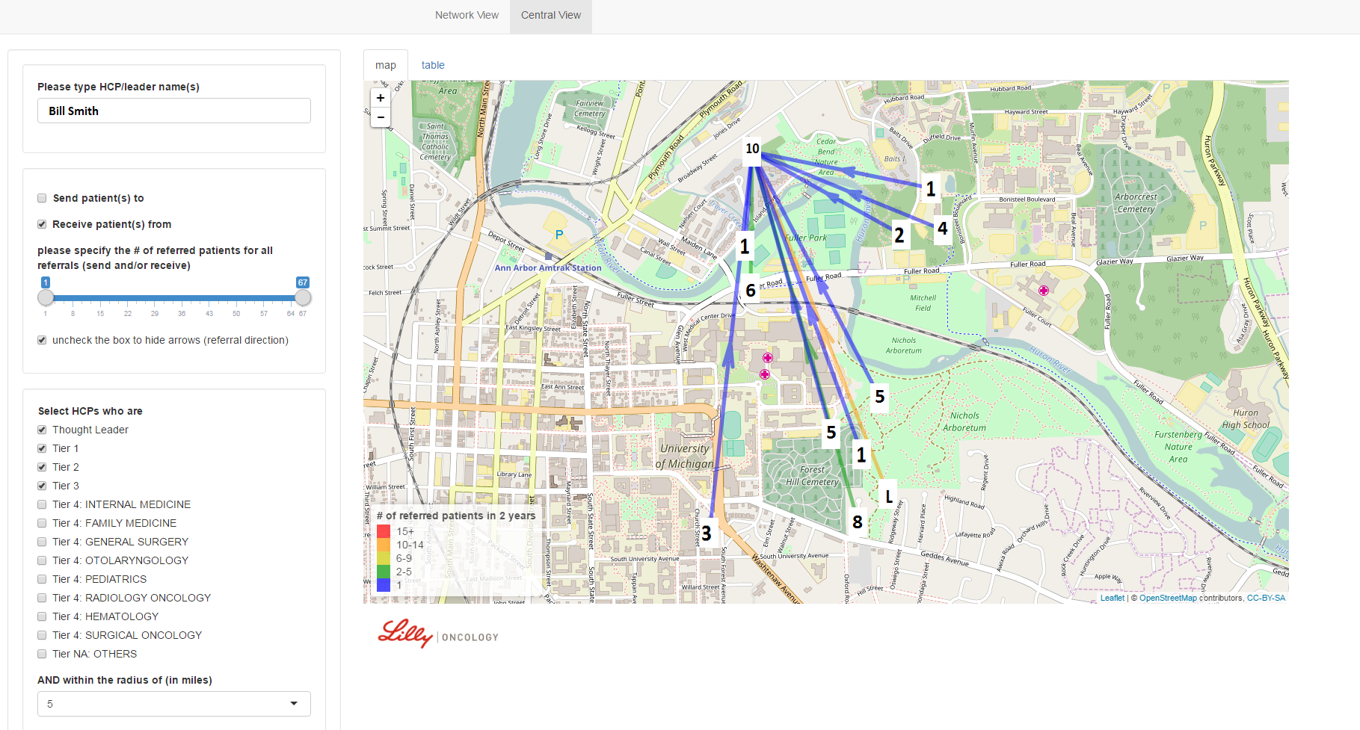
Central View: a Closer Look

Slide 12
How was the visualization tool built?

Slide 13
Data
Anonymized
Patient-level
Database
External Data Source
Extract relevant information
Referral
Database
Internalize Data
Organize data
Create Visual Analytics Capability
Visualization
Tool

Slide 14
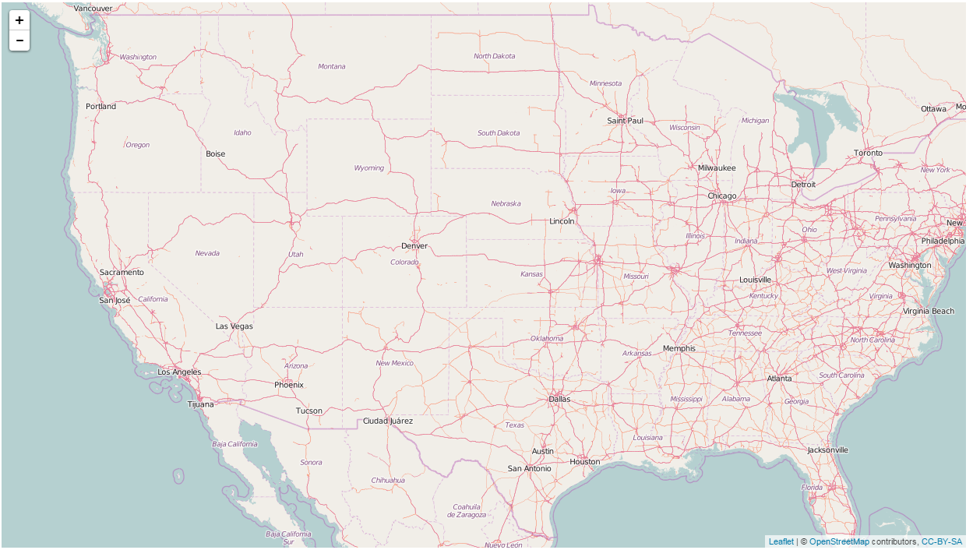
Map
library('leaflet')
# render leaflet object
leaflet() %>%
addTiles()
The default map service is provided by
OpenStreetMap and accessed through the leaflet::addTiles() function

Slide 15
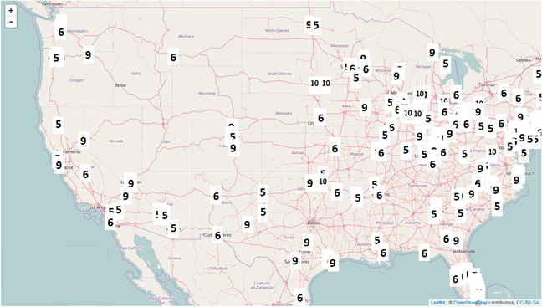
Markers, Popups etc.
library('leaflet')
# render leaflet object
leaflet() %>%
addTiles() %>%
addMarkers(...)

Slide 16
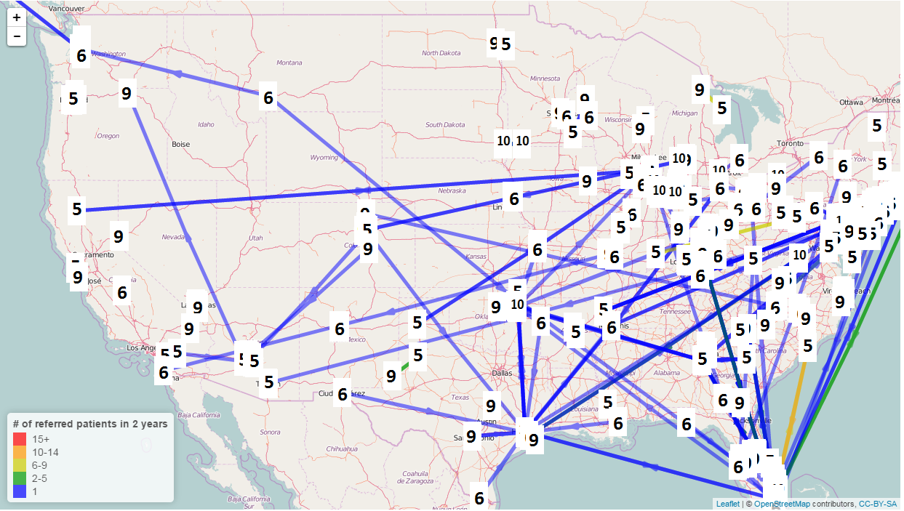
Lines
library('sp')
spg.place.holder <- SpatialPolygonsDataFrame(…)
library('leaflet')
# render leaflet object
leaflet() %>%
addTiles() %>%
addMarkers(...) %>%
addPolylines(spg.place.holder ) %>%
addLegend(...)

Slide 17
Make it interactive!

Slide 18
server<- function(input, output) {
}
input
output

Slide 19
Summary
The brand team was very enthused
Flexible
Extremely valuable
Easy to use
The tool has been adopted by other brands

