Slide 1
Recommendations on integrated safety summaries from Phase 1 studies
Janssen Research & Development
Sveta Weiner, MS

Slide 2
Goals of the presentation
1. Overview of phase 1 trials
- Definition
- Objectives
- Conduct
- Study design
- Types of studies
2. ISS issues
- General
- Subject population
- Dosing
- Pooling challenges
- Example
3. Recommendation

Slide 3
Definition and objectives of phase 1 study
A closely monitored research study of a drug or vaccine conducted in a small number of healthy volunteers or sometimes patients
is the new experimental treatment safe and tolerable?
formulation differences (e.g., by mouth or through a blood vessel)
doses and drug plasma levels are associated with therapeutic effect
pharmacokinetics (what the body does to a drug)
pharmacodynymics (what drug does to the body)

Slide 4
Some of the critical information from phase 1 study is….
How does half-life of a drug vary among subjects? Among different types of patients?
Is the half-life different after a single dose comparing to stable dosing?
Is the drug’s metabolism, effectiveness, or toxicity affected by other drugs that might be taken concomitantly?

Slide 5
Design and population
Typically conducted in healthy volunteers
Patients may be included when information it is impossible to extrapolate to patient population (e.g., antibacterials, antipsychotic drugs, anti-HIV drugs)
Total number of subjects included varies by drug, but generally in the range of 20 to 80
Important decisions in designing
- Early Development (ED) phase 1 study: selection of subjects, choosing a starting dose, rules for dose escalating, and methods for determining the MTD or safe dose
- Clinical Pharmacology (CP) phase 1 PK study: conmeds, SD/MD, selection of design (crossover, single dose, parallel), number of doses

Slide 6
Designs commonly used in Phase 1 studies
Crossover: Each subject receives all treatments in a random order. In 2-way crossover, half of the subjects receive Treatment A followed by Treatment B and the other half receives Treatment B first and then A; a washout period separates the two treatment periods.
Single-sequence designs: All subjects receive all the treatment in the same order. Mostly used in drug-drug interaction (DDI) studies (Treatment A followed by Treatment A+B; effect of B on the PK of A)
Parallel group design: Each subject is assigned to one and only one treatment.
- useful for PK studies if the drug has a long half-life
- used in ED studies where subjects are randomized between a dose of active treatment and placebo

Slide 7
Type of Studies
Single Ascending Dose studies (SAD)
Multiple Ascending Dose studies (MAD)
Food effect
Drug-Drug Interaction studies
Bioavailability(BA) / Bioequivalent (BE) studies
Dose proportionality studies
Special population studies
Special safety studies (TQT)
Special PD studies (e.g., effect of the drug on glucose levels)

Slide 8
Single Ascending dose studies
Small groups of subjects are given a single dose of the drug while they are observed and tested for a period of time. If no AEs, and the pharmacokinetic data is roughly in line with predicted safe values, the dose is escalated (new group of subjects is then given a higher dose)
If unacceptable toxicity is observed, an additional number of participants are treated at the same dose; continued until pre-calculated PK safety levels are reached, or intolerable side effects start showing up (at which point the drug is said to have reached the Maximum tolerated dose (MTD)).
If an additional unacceptable toxicity is observed, then the dose escalation is terminated and that dose, or perhaps the previous dose, is declared to be the maximally tolerated dose.

Slide 9
Multiple ascending dose studies
Studies conducted to better understand the PK & PD of multiple doses of the drug.
Group of subjects receives multiple low doses of the drug, while samples (of blood, and other fluids) are collected at various time points and analyzed to acquire information on how the drug is processed within the body. The dose is subsequently escalated for further groups, up to a predetermined level.

Slide 10
Food effect studies
A short trial designed to investigate any differences in absorption, distribution, metabolism, excretion (ADME) of the drug by the body, caused by eating before the drug is given.
Usually run as a crossover study, with volunteers being given two identical doses of the drug while fasted, and after being fed.

Slide 11
Drug-Drug Interaction Studies
Modification of the effect of a drug when administered with another drug.
PK profile may be an increase or a decrease in the action of either substance, or it may be an adverse effect that is not normally associated with either drug.
The particular interaction may be the result of chemical-physical incompatibility of the two drugs, change in the rate of absorption or the quantity absorbed in the body, the binding ability of either drug, an alteration in the ability of receptor sites and cell membranes to bind either drug

Slide 12
Bioavailability and Bioequivalence studies
Bioavailability - amount of drug that is available to the circulatory system in its unchanged form, and the rate at which it is made available
Bioequivalence study – the blood-level profile of a drug arising from single administration of a single dose of formulation A is compared with that from a similar administration of formulation B

Slide 13
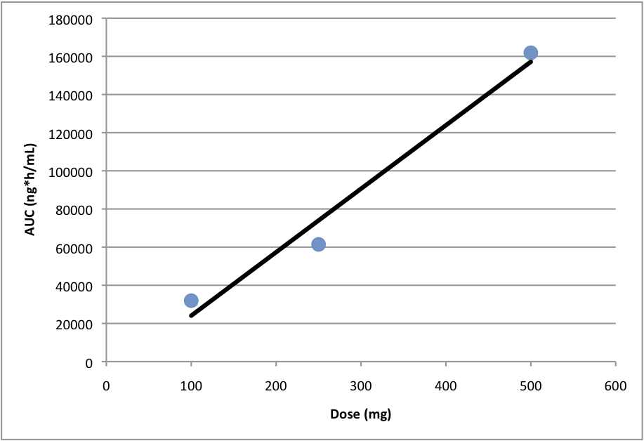
Dose Proportionality Study
Dose proportionality occurs when increases in the administered dose are accompanied by proportional increases in a measure of exposure like AUC or C_{max}. Thus an evaluation of dose proportionality usually includes exposure analysis of 3 or more doses to produce a graph similar to the one below:

Slide 14
Special population studies
Hepatic impairment (inability of the liver to perform its normal synthetic and metabolic function as part of normal physiology)
Renal impairment (kidney fail to filter toxins from bloodstream)
Elderly population (65 years old and older)

Slide 15
Other studies…
Cardiovascular safety study (TQT)
PD studies (e.g., effect of the drug on glucose level)
Safety studies (orthostatic hypotension study)

Slide 16
Phase 1 safety for submission
most phase 1 studies are PK oriented; designed to measure the absorption, distribution, metabolism, excretion (ADME), and toxicity of a new drug
by their nature phase 1 studies are small and tremendously vary in their scope and design
most companies generate integrated safety summaries of AEs, lab measurement, vital signs and ECG measurement for PHASE 1 studies (ED and CP studies)
regulatory guidelines are limited on the topic of pooling - > leads to different methods of analysis
European agencies require submission to be more complete
internal view

Slide 17
Phase 1 studies for ISS
What is the best strategy to pool studies
- of different designs
- of different dosing schemes
- of different subjects populations

Slide 18
Challenges of pooling phase 1 safety studies
Different study design
Different populations
dosing (single dose vs. multiple doses)
- in single dose studies there is not enough time to see all the safety issues
- therapy doses are separate
concomitant medications (drug-drug interactions studies) [is the AE happening because of one of another drug]
lack of placebo in most studies [the use of a placebo allows the researchers to isolate the effect of the study treatment from the placebo effect]

Slide 19
Example: why three groups
pooled based on subject population and number of doses into three different groups for a separate analysis:
Single Dose Studies in normal healthy volunteers: 14 studies in healthy subjects who received single dose of our drug [open-label and double-blind studies]
(2) Multiple Dose Studies in normal healthy volunteers: 16 studies in healthy subjects who received multiple doses of our drug [open-label DDI studies, and positive controlled studies, crossover studies, parallel studies]
(3) Phase 1 Multiple Dose Studies in patients: 4 studies in target patients[double-blind and open-label studies]

Slide 20
Example: Implementation of pooling
Formulation: Tablet and oral suspension formulations were combined based on dose.
Food: Fed and fasted regimens were combined based on dose.
Conmeds:
- positive controls from respective studies were excluded.
- for drug-drug interaction studies, drug of interest only, and drug of interest + interacting agent treatments were combined into one group based on drug of interest dose
Design:
- the integrated dataset for each group included data from both parallel group and crossover design studies
- all analysis was done separately for each pooled group

Slide 21
Example: Dosing
All results were summarized by the following pooled treatment groups-
Placebo: All placebo treatments from different studies
Study drug < 200mg qd: Treatment with less than 200 mg/day of med
Study drug 200 mg qd: Treatment with 200 mg/day of med
Study drug > 200 mg qd: Treatment with greater than 200 mg/day of med
All Study drug: All doses of med combined

Slide 22
Examples of reporting tables

Slide 23
Demographics, Disposition

Slide 24
Exposure
A frequency distribution of duration of exposure comprising the number and percent of subjects who received study medication for all the appropriate groups of pooled phase 1 studies:

Slide 25
Adverse Events

Slide 26
Data not for pooling
Analysis of Laboratory Abnormalities, vitals, and ECG
The abnormalities best should be discussed based in the individual studies CSRs
- different schedule of labs, vitals, and ECG collection across the studies makes pooling such information hard to interpret – ED vs. PK
– safety monitoring

Slide 27
Pros and Cons of pooling safety data for phase 1 studies
European agency requirements + Internal within company requirements
Benefits:
- Being able to look for a signal for AEs; calculate overall exposure; define total dropout
Challenges:
- Difficulties with interpretation; Difficult to pool: rules for pooling have to be agreed upon; SD may not be sufficient to see the safety profile; healthy volunteers safety data may not reflect actual clinical practice; what is the worth of ISS with single dose in HV
- Very limited use of lab summaries and interpretation is limited
In conclusion….
Sponsors should provide critical information based on pooled dataset: total number of subjects exposed, total duration, overall demog, AEs; vitals, ECGs, Labs are not recommended for pooling due to having different schedules
Discussion between clinicians and stats should be ongoing and should start early

