Slide 1
Shiny Tools for Sample Size Calculation in Process Performance Qualification of Large Molecules Qianqiu (Jenny) Li, Bill Pikounis May 24, 2017

Slide 2
Tools & Methods: VarCompLM Outputs
Variance Estimates:
Based on EMS (Expected Mean Squares): the expected mean square for a model effect is a linear combination of variance components and fixed effect values, including the residual error variance.
Based on likelihood: maximum likelihood estimates
Confidence Intervals for Variances:
Satterthwaite & SAS-specific (EMS-Based)
Wald & Parametric Bootstrap (Likelihood-Based)
Others:
Confidence Intervals of Fixed Effects Means
Outputs from fitting lme and lmer
Graphs: plot of data against each random effect

Slide 3
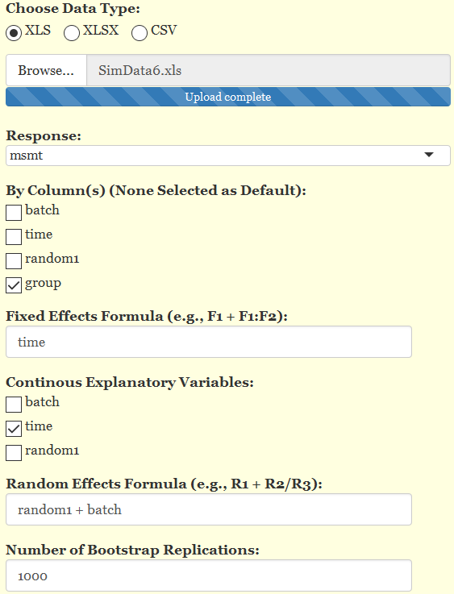
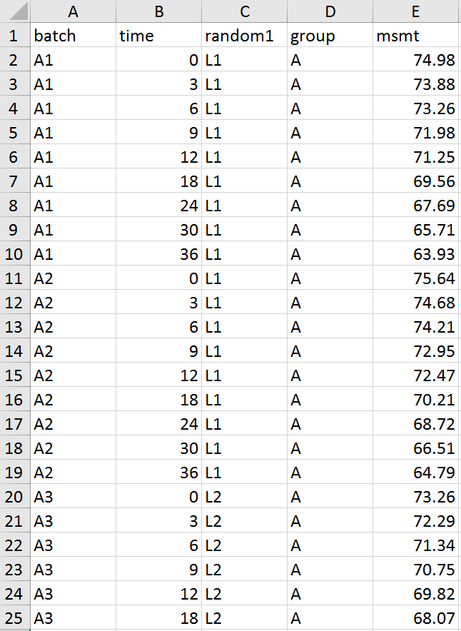
Tools & Methods: VarCompLM Illustration
1~25 rows in SimData6.xls

Slide 4
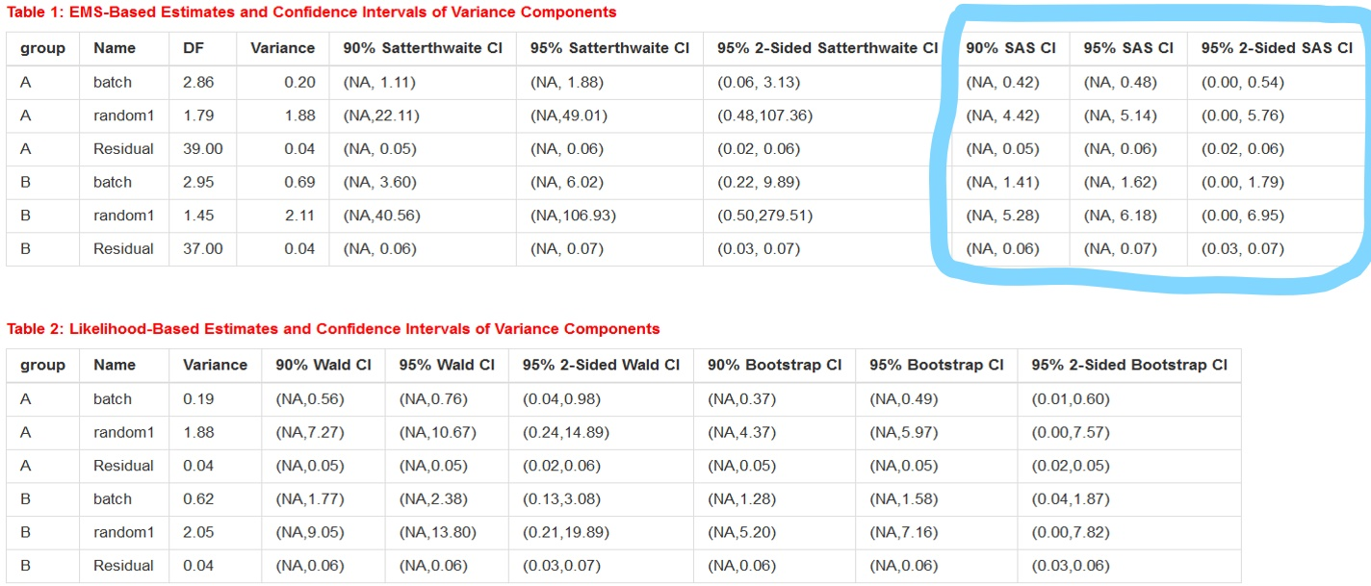
Tools & Methods: VarCompLM Confidence Intervals for Variances

Slide 5
Tools & Methods: VarCompLM Confidence Intervals for Variances
EMS-Based Confidence Intervals for Variances:
Satterthwaite (1946): e.g., $if {\hat{ω}}^{2}=\sum_{m=1}^{M}{q_{m}{MS}_{m}}$, then
$100\left(1−α\right)\%$ 2-sided CI is $\left(\frac{f{\hat{ω}}^{2}}{χ_{f,\frac{α}{2}}^{2}}, \frac{f{\hat{ω}}^{2}}{χ_{f,1−\frac{α}{2}}^{2}}\right)$
$$DF of {\hat{ω}}^{2}:f=\frac{{\left({\hat{ω}}^{2}\right)}^{2}}{\sum_{m=1}^{M}{\frac{{\left(q_{m}{MS}_{m}\right)}^{2}}{ν_{m}}}} ν_{m} is the DF w.r.t. {MS}_{m}$$
SAS-specific: using the same rule as in SAS 9.2 PROC MIXED with option “method=type1”, e.g., $100\left(1−α\right)\%$ 2-sided CI
$${\hat{ω}}^{2}±Z_{1−\frac{α}{2}}\sqrt{\hat{VAR}\left({\hat{ω}}^{2}\right)}$$
$\hat{VAR}\left({\hat{ω}}^{2}\right)$ obtained by Giesbrecht and Burns (1985): Two-Stage Analysis Based on a Mixed Model: Large-Sample Asymptotic Theory and Small-Sample Simulation Results, Biometrics 41, p. 477-486

Slide 6
Tools & Methods: VarCompLM Confidence Intervals for Variances
Likelihood-Based Confidence Intervals for Variances:
Wald: lme object (using function intervals in package nlme)
Assumption: log-scaled variances follow normal
distributions
Parametric Bootstrap: lmer object; computationally expensive!
https://www.rdocumentation.org/packages/lme4/versions/1.1-12/topics/confint.merMod
https://www.rdocumentation.org/packages/lme4/versions/1.1-12/topics/bootMer

Slide 7
Tools & Methods: VarCompLM Illustration
Fixed: time + group
Random: random1 + batch
Fixed:
Random: random1 + batch + group
Fixed: time + group:time
Random: batch + random1

