Slide 1
RNA sequencing : Opportunities and Challenges
Midwest Biopharmaceutical Statistics Workshop
May 21, 2013
Philip Ebert, Eli Lilly and Company

Slide 2
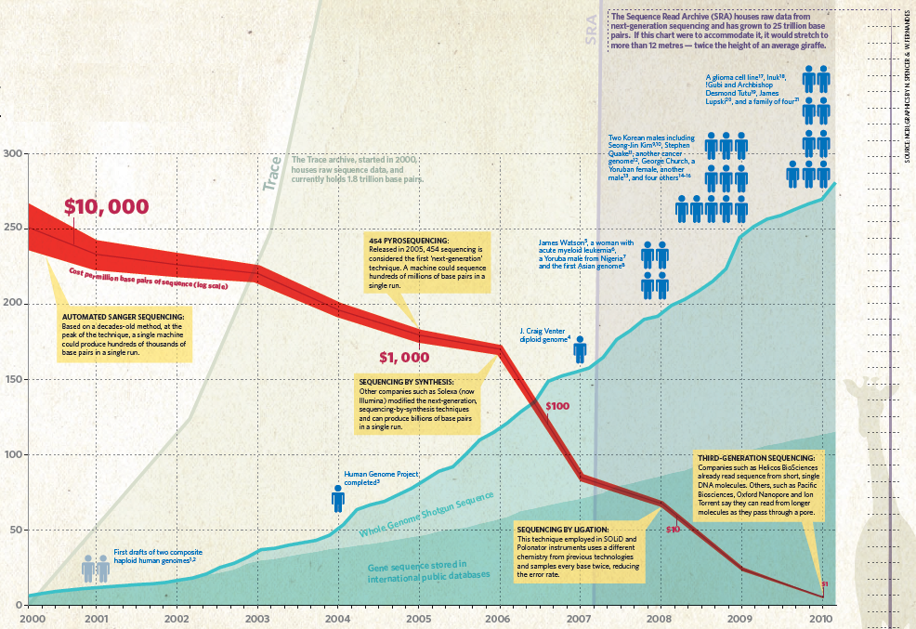
Human genome at ten: The sequence explosion
Nature 464, 670-671 (2010)

Slide 3
Outline
What is RNAseq?
How does it work?
Advantages to microarray
Current challenges
What are the key questions for an RNAseq experiment?
Wet-lab
In silico
What aspects of RNAseq most impact data analysis?
Experimental design
Quality control
Sequencing bias

Slide 4
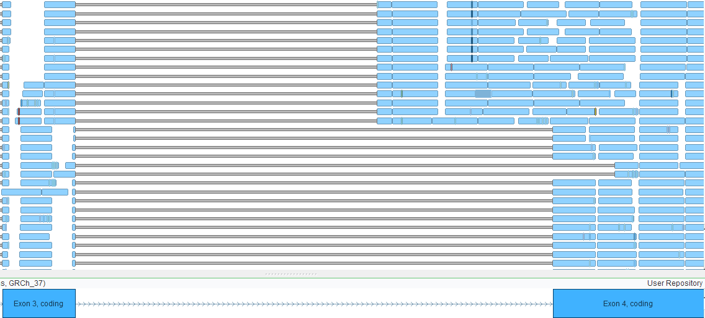
What is RNA sequencing?
Massive parallel sequencing of single RNA molecules
Millions of RNA-derived cDNA fragments per sample
Assembling the sequences into transcripts

Slide 5
Illumina sequencing by synthesis
Illumina technical brochure

Slide 6
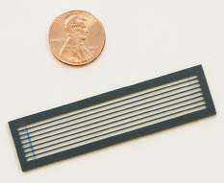
Sequencing apparatus
Illumina technical bulletin

Slide 7
Workflow

Slide 8
RNAseq advantages over microarray
Single-molecule resolution
Can be used for mRNA, miRNA, ncRNA
More quantitative (digital) expression analysis
Not restricted to prior knowledge (probe on array)
Discovery of novel isoforms/genes
Mutation and novel germline SNP detection
Translocation detection
Notes:
8

Slide 9
Reproducibility and sensitivity

Slide 10
Reduced processing bias

Slide 11
RNAseq
Challenges
Analysis of data is computationally intense
Data storage requirements
Resolution of different isoforms is not straightforward
May require multiple different types of analysis
QC and statistical analysis practices are still being developed

Slide 12
Outline
What is RNAseq?
How does it work?
Advantages to microarray
Current challenges
What are the key questions for an RNAseq experiment?
Wet-lab
In silico
What aspects of RNAseq most impact data analysis?
Experimental design
Quality control
Sequencing bias

Slide 13
Key Questions/Decisions
Decide the optimal method for specific needs
Length of read; Depth of sequencing; Strand identity
Experimental design
Technical/biological replicates; Barcoding/randomization
Decide how to analyze
Standard Workflow
QC (3’ bias, contamination, base quality)
Biological Impact
Isoform prediction
Translocation detection

Slide 14
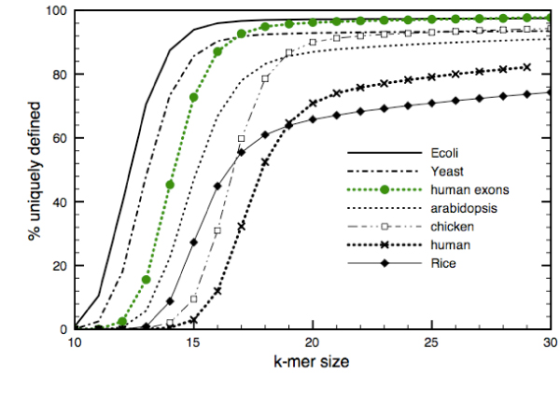
Read Length dependence
Short reads are more affected by repetitive regions
Shorter reads provide less information about splice isoforms, and are more affected by random error/polymorphisms

Slide 15
Sampling methods
Auer and Doerge Genetics (2010) 185: 405–416

Slide 16
Transcript prediction
Martin and Wang, Nature Reviews Genetics (2011) 11:671-682

Slide 17
Outline
What is RNAseq?
How does it work?
Advantages to microarray
Current challenges
What are the key questions for an RNAseq experiment?
Wet-lab
In silico
What aspects of RNAseq most impact data analysis?
Experimental design
Quality control
Sequencing bias

Slide 18
Quality control metrics
“One of these things is not like the other!”
- Mr. Rogers
Lilly internal data

Slide 19
Error rate – Quality trimming
Wang et al. Nature (2008) 456:470-476
Kircher et al. Genome Biology (2009) 10:R83

Slide 20
3’ bias
Wang et al. Nat Rev Genet (2009)10:57-63

Slide 21
Systematic error
Meacham et al. BMC Bioinformatics (2011) 12:451

Slide 22
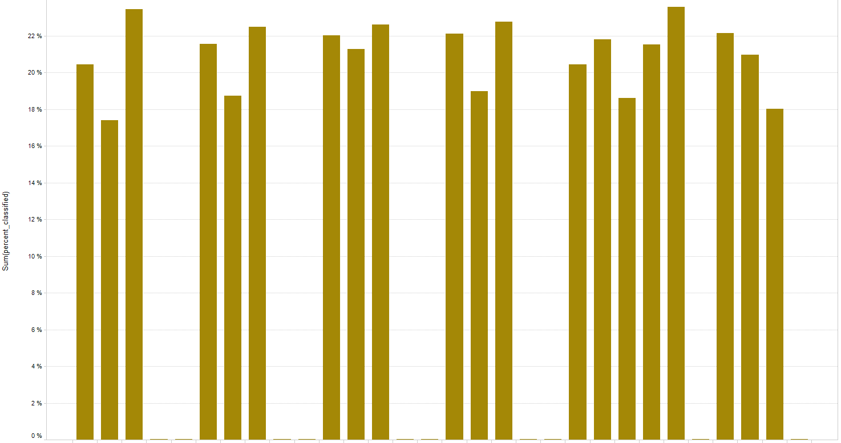
Viral RNA contamination
Results in reduced depth of sequencing of endogenous mRNA
Lilly internal data

Slide 23
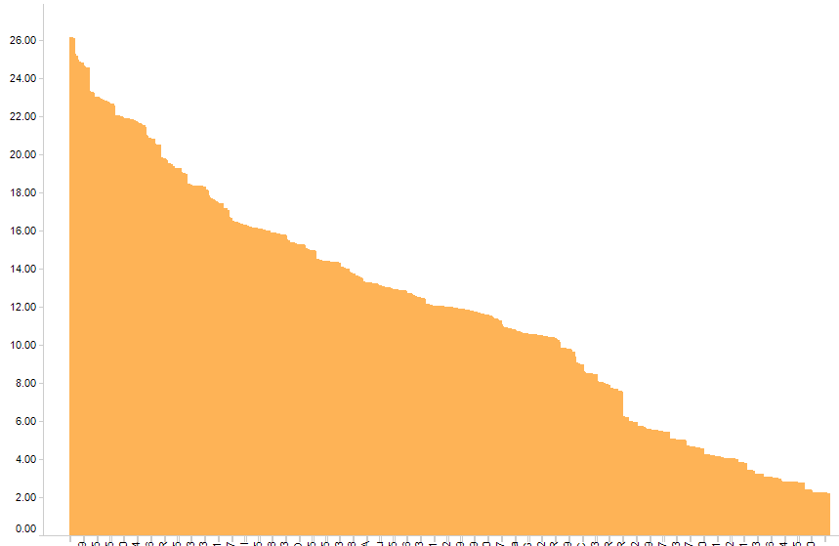
Mitochondrial content
% of reads pre-mapping
Removal of mitochondrial reads before normalization recommended.
Lilly internal data

Slide 24
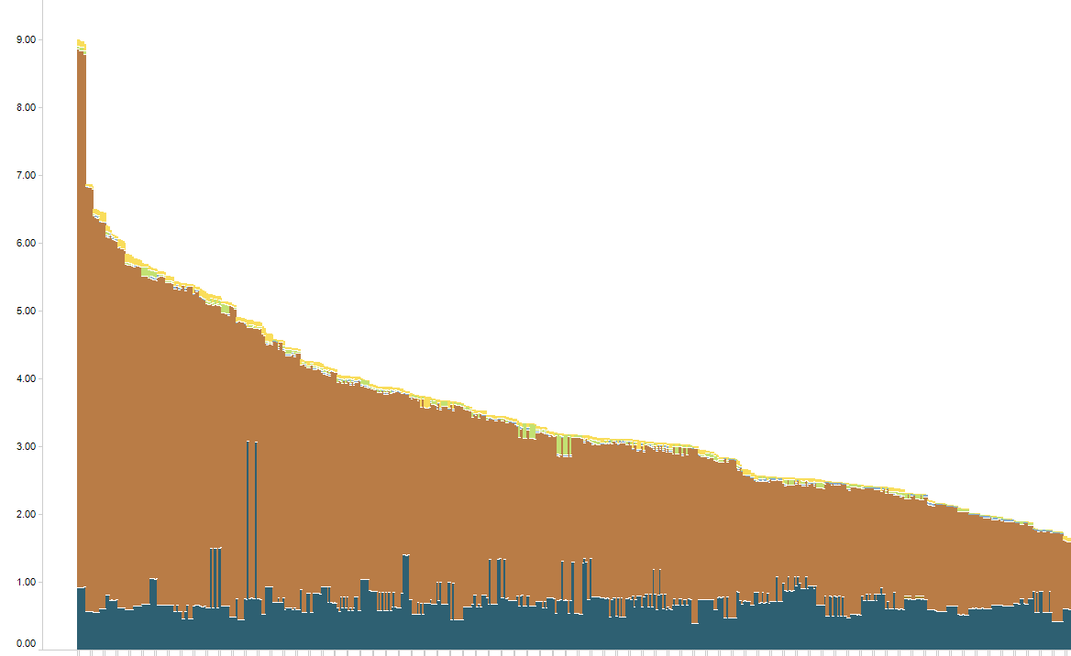
rRNA contamination
% of reads pre-mapping
Removal of rRNA reads before normalization recommended.
Lilly internal data

Slide 25
Summary
RNA sequencing is a powerful technology which is opening up new possibilities for interrogation of the transcriptome
This extends beyond traditional differential expression analysis to digital quantitation at the single transcript level
As with any technology, there are still growing pains, including the methodologies utilized to assess the quality of the data and quantify the significance of results
We need your help!
ebertpj@lilly.com

