Slide 1
Statistical Impact/Influence on Regulatory
Brent Harrington
Director
Pharm Sci & PGS Statistics
Pfizer Inc
2014 Midwest Biopharmaceutical Statistics Workshop
May 19-21, 2014

Slide 2
Acknowledgements
Kimber Barnett
James Bergum⁵
Todd L. Cecil²
Tom Garcia
Tim Graul
Oliver Grosche³
Melissa Hanna-Brown
Jeff Hofer⁴
Phil Nethercote¹
John Peterson¹
Kim Vukovinsky
Chad Wolfe⁴
Loren Wrisley
  GlaxoSmithKline
  United States Pharmacopeia
  Novartis
  Eli Lilly
  Consultant

Slide 3
Outline
A Few Successful Applications of Statistical Methods and Thinking
  A 20+ year reflection
  Pharmaceutical Development in the 21st Century
  Successful Applications of Statistical Methods in the 21st Century
Opportunities

Slide 4
Success Story … 20th Century
Analysis of Stability Results – Confidence on the Mean utilizing ANCOVA
1987 Guideline for Submitting Documentation For The Stability of Human Drugs and Biologics

Slide 5
Success Story … 20th Century
Multiple Criteria for Standards; USP<711>, USP<905>
Table 1. USP<711> Acceptance Table 1
Stage | Number Tested | Acceptance Criteria
S1 | 6 | Each unit is not less than Q+5%
S2 | 12 | Average of 12 units (S1+S2) is ≥ Q, and no unit is <Q-15%
S3 | 24 | Average of 24 units (S1+S2+S3) is ≥ Q, not more than 2 units is < Q-15%, and no unit is <Q–25%

Slide 6
Success Story … 20th Century
Probability of Meeting Standards

Slide 7
Success Story … 20th Century
Fractional Factorial Application to Stability Study Designs
Examples provided in ICH Q1D
Strength
50 mg
75 mg
100 mg
Batch
A
B
C
A
B
C
A
B
C
Cont.
Size
50 ct
T1
T2
T2
T1
T1
T2
100 ct
T2
T1
T1
T2
T1
T2
500 ct
T1
T2
T1
T2
T2
T1

Slide 8
New Initiatives!! – Moving Beyond the 20th Century?
Inititiative: FDA – Pharmaceutical Quality in the 21st Century – 2003
  Encourage Application of science to better understand processes
Guidance Documents
  FDA – Blend Uniformity – 2003
  FDA – Analytical Validation - 2014
  ICH – Q1A(r2), Q1D, Q1E – 2003
  ICH –Q2, Q6, Q8, Q9, Q10, Q11 – 2005-2012
  USP<1010> - 2010
  USP Stimuli to the Revision Process
      Acceptable, Equivalent, or Better… - 2009
      Performance Based Monographs - 2009

Slide 9
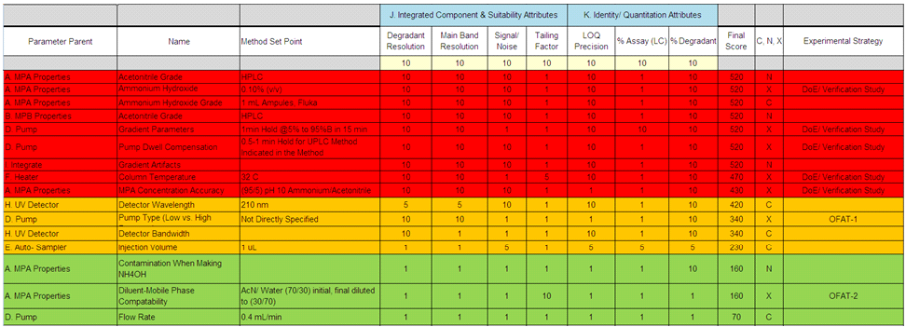
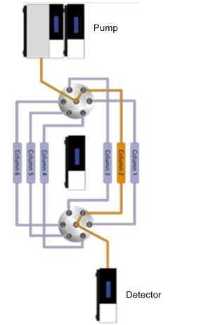
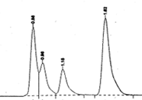
Risk Assessment + DoE Strategy
Standard & Sample Preparation
Chromatography (Method)
The level of effort, formality and documentation of the quality risk management process should be commensurate with the level of risk (ICH Q9)
Result

Slide 10
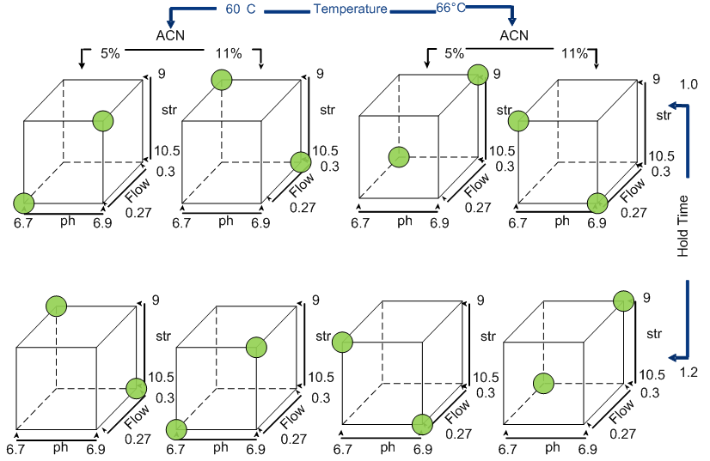
Design of Experiments
Method Development Experiments – Define the ranges that provide control of the measurement system
DoE Strategy - sequential exploration and modeling -dependent upon the knowledge of the system, and the costs/resources available.

Slide 11
Contour Plots of Two Responses & Two PP’s

Slide 12
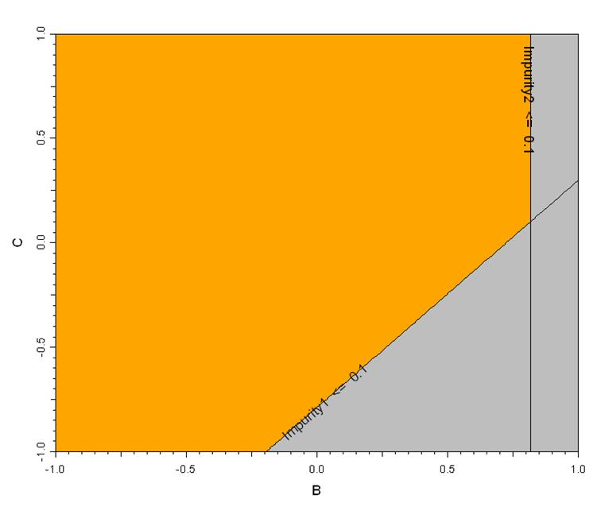
Overlay Plot of Two Responses vs. Two PP’s
Easy to implement.
Lends to “Edge of Failure” Terminology
“EOF” is misleading.

Slide 13
Overlay Plot of Two Responses vs. Two PP’s
The probability of simultaneously passing the specifications varies within in the yellow region
“Boundary” provides no greater than 50% probability of passing
The combined probabilities decrease in areas of intersecting requirements
~50% Prob
< 50% Prob
~50% Prob

Slide 14
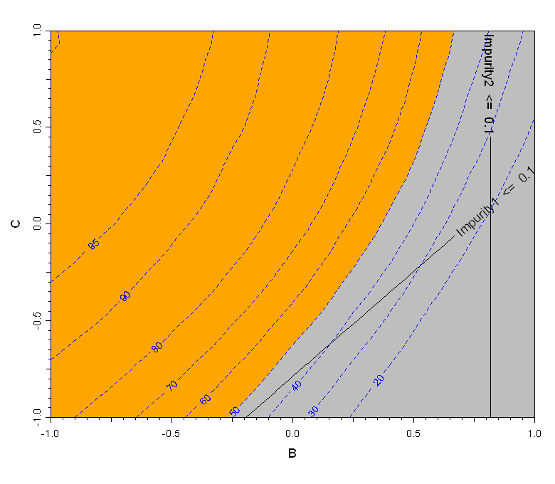
Success Story … Prospective Process Reliability Estimate (PPRE)

Slide 15
Issues?
Reality – Pharmaceutical Development is highly regulated
  Real or perceived regulatory hurdles cause Compliance-driven rather than Process Understanding-driven development
    No clear definition of relevant measure exists
      What measure (reportable value) assessed against specifications?
    No incentive for providing additional testing to increase confidence in scientifically risk-based decisions

Slide 16
Regulatory Criteria
    ICH Q6A/B (Specifications):
      Acceptance Criteria are limits that each individual reportable value is expected to meet
    ICH Q1E (Evaluation of Stability Data):
      The 95% confidence limit(s) for the batch mean must remain within Acceptance Criteria to justify the product expiry dating.
      The Acceptance Criteria are assumed to be known with dating justification as the goal.
USP:
  Not statistical tests, but standards
  Any official article is expected to meet compendial standards if tested
  Inference only applies to the tested units

Slide 17
Regulatory Criteria
FDA Out of Specification (OOS) Guidance
  “In cases where a series of assay results (to produce a single reportable result) are required by the test procedure and some of the individual results are OOS, some are within specification, and all are within the known variability of the method, the passing results are no more likely to represent the true value for the sample than the OOS results.
  For this reason, a firm should err on the side of caution and treat the reportable average of these values as an OOS result, even if that average is within specification.
  This approach is consistent with the principle outlined in the USP General Notices that an official article shall comply with the compendia standard any time a compendia test is applied. Thus, every individual application of the official test should be expected to produce a result that meets specifications.”

Slide 18
Regulatory Criteria
 | Interpretation of Regulatory Acceptance Criteria
Topic | ICH | USP | FDA OOS Guidance
Specifications | Overall batch mean (Q1) Reportable Value (Q6) | Reportable Value | Each replicate in a Reportable Value
Individual dosage units?
All of the above interpretations are not aligned
Reportable values?
Batch Mean?

Slide 19
Regulatory Criteria
Specifications are arrived at via negotiation
Limited manufacturing experience at time of negotiation
Rarely clinically driven but typically performance driven – this is the case for drug product potency, but not necessarily impurities
  Established based upon reportable values
  Often minimally wider than capability (3-sigma) limits
  Leads to low capability by definition

Slide 20
Process Capability … the reality
Cp < 1
Negotiation with regulators often ends up with specs similar to the middle picture
On the edge of capability for reportable values
Cp = 1
Cp > 1

Slide 21
The Measurement System
Complex
Destructive
Atypical results rare but inevitable
  Lack of clarity on acceptable investigation practices
Often most observed variation is measurement
  Little true process variability
  Little discrimination ability within specification range

Slide 22
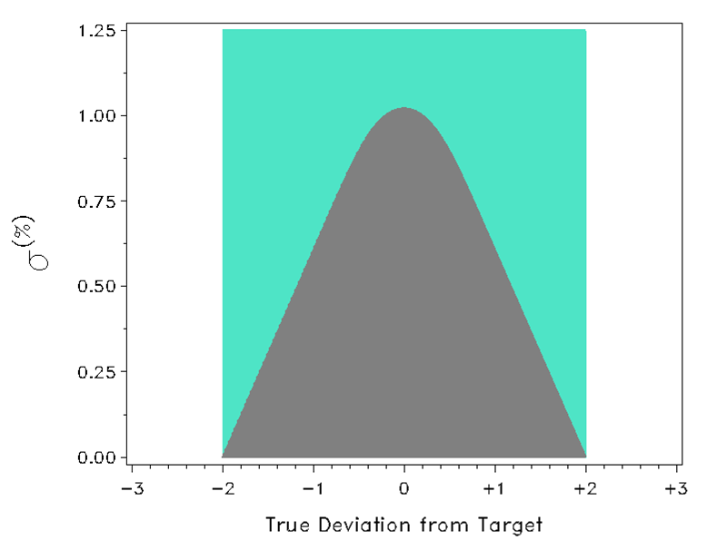
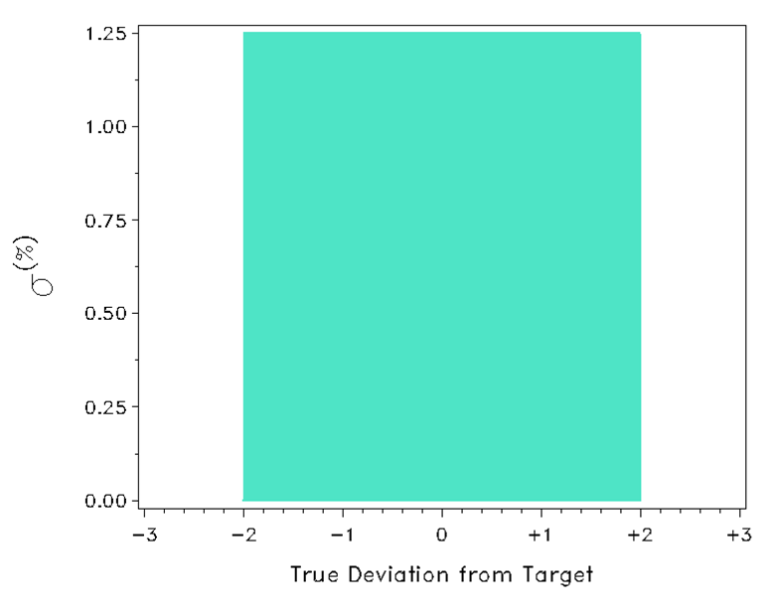

Graphical Representation of
Traditional Method Validation Criteria
Graphical Representation of
ATP Method Validation Criteria
Accuracy and Precision with Independent limits/criterion
The procedure must be able to
accurately quantify the Drug product over a range of 98% to 102% of the nominal concentration with accuracy, and precision such that measurements fall within ± 2.0% of the true value at least a 95% probability.
No trade-off between increasing method bias and/or variability
Criteria:
Bias of NMT 2.0% &
Variability of NMT 1.25%

Slide 23
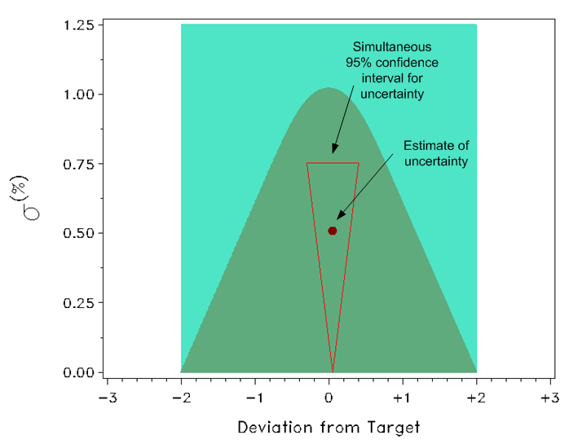
Success – ATP verification
Appropriate Sample Size to Assess Acceptance Criteria
Developing “Equivalent or Better” Methods
Verification of meeting ATP criterion is illustrated via simultaneous conf interval on accuracy and precision estimates from data realized under experimental conditions
  *E2709 – 10: Demonstrating Confidence in Complying with Acceptance Procedures

Slide 24
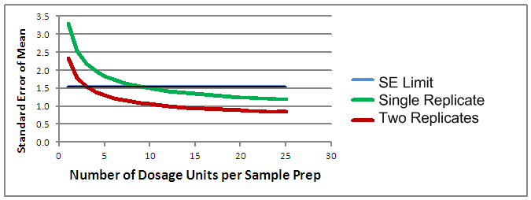
Success – Potency Assay Sample Strategy
Preparation is 20% and Dosage Unit is 80%of Total Variability

Slide 25
Opportunities
Define reportable result as reliable estimation of batch parameter
  Summary measures such as the mean provide greater information about the attribute
Differentiate between acceptance criteria (limits) and process control limits
  Acceptance criteria should ensure safety and efficacy performance
  Data-driven signals define what the process is capable of delivering
Recognize the value of additional testing
  Link sample size and acceptance criteria to manage risk

Slide 26
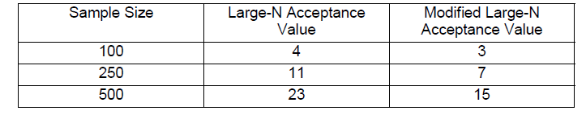
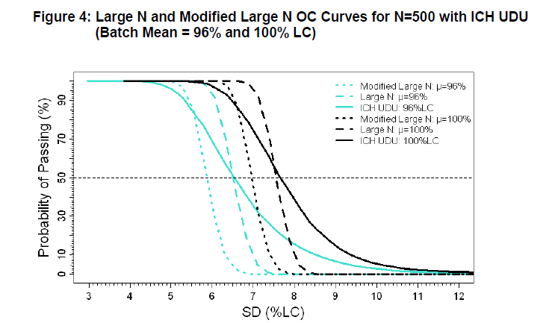
UDU Acceptance
Link Sample Size to Acceptance Criteria
Use OC of test to determine discrimination

Slide 27
Are there other Methods? Relevance?
Probability of Meeting Standards

Slide 28
Path Forward
Continue to develop appropriate experimental plans and methods that promote risk-based decision making
Engage R&D, Compendia and Regulatory authorities to work together in constructive dialogue concerning measurements and inferences made from those measurements
Systems should not discourage the gathering of greater amounts of data, and appropriate statistical techniques must be used when needed.

Slide 29
Thank you, for your attention!
Abbreviated Reference List:
  Pharmacopeial Forum, Vol. 35(3) [May-June 2009], Stimuli to the Revision Process; Performance-based Monographs, 765-771
  Fanali, S., Haddad, P.R., et. al. (2013). Liquid Chromatography Applications. Waltham, MA: Elsevier
  EURACHEM Working Group. (2000). Quantifying Uncertainty in Analytical Measurement.
  Draft paper A Simple Parametric Bootstrap Approach to Computing Design Space Probabilities by John Peterson of GlaxoSmithKine
  Reid, George; et al; Analytical Quality by Design (AQbD) in Pharmaceutical Development. American Pharmaceutical Review. Vol. 16, issue 5.
  1987 FDA Guideline: “Guideline for Submitting Documentation for the Stability of Human Drugs and Biologics”
  ICH Quality Guidance: Q1A(r22), Q1D, Q1E, Q8, Q9, Q10, Q11
  USP General Chapters: <1010>, <724>, <905>
  Chow, Liu (1995). Statistical Design and Analysis in Pharmaceutical Science. Dekker. NY.

