Slide 1
Establishing Validation Acceptance Criteria on the Observed Mean and Standard Deviation for 2-Sided Dissolution Specifications Using Bayesian Methodology and Simulation
Thomas Parks, Eli Lilly & Co
Adam Rauk, Inventive Health

Slide 2
Outline
Background on USP dissolution test <711>
Defining the problem
  Specifications on an extended release product
  Statistically supporting criteria for validation
Approaches
  ASTM E2709, “Standard Practice for Demonstrating Capability to Comply with a Lot Acceptance Procedure” (the “Bergum method)
    CuDAL (Content Uniformity and Dissolution Acceptance Limits) is validated software for calculating one-sided limits
  Bayesian approach using conjugate priors
Distributions/Model
Simulation
Results
References

Slide 3
Background on USP <711> Dissolution Test
Purpose
  To provide in vitro drug release information
Uses
  Quality control including batch-to-batch variability
  Surrogate for in vivo testing through In Vitro/In Vivo Correlations (IVIVC)
International Conference on Harmonisation (ICH)
  The USP General Chapter <711> Dissolution test is harmonized with Europe and Japan

Slide 4
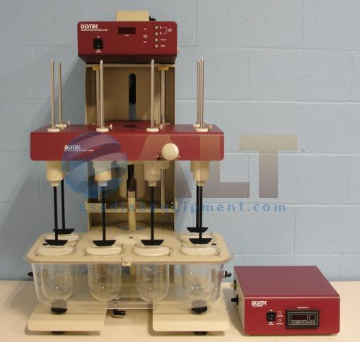
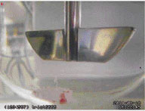
Dissolution Setup (Apparatus 2, Paddle)

Slide 5
Dissolution USP Test – General
USP <711> is a multi-stage test
  Stage 1: Sample 6, if fail Stage 1 criteria then
  Stage 2: Sample additional 6, if fail Stage 2 criteria then
  Stage 3: Sample additional 12 and assess against Stage 3 criteria
Total of up to 24 dosage units could be tested for a single batch
Applies to immediate release, extended release, and delayed release dosage forms

Slide 6
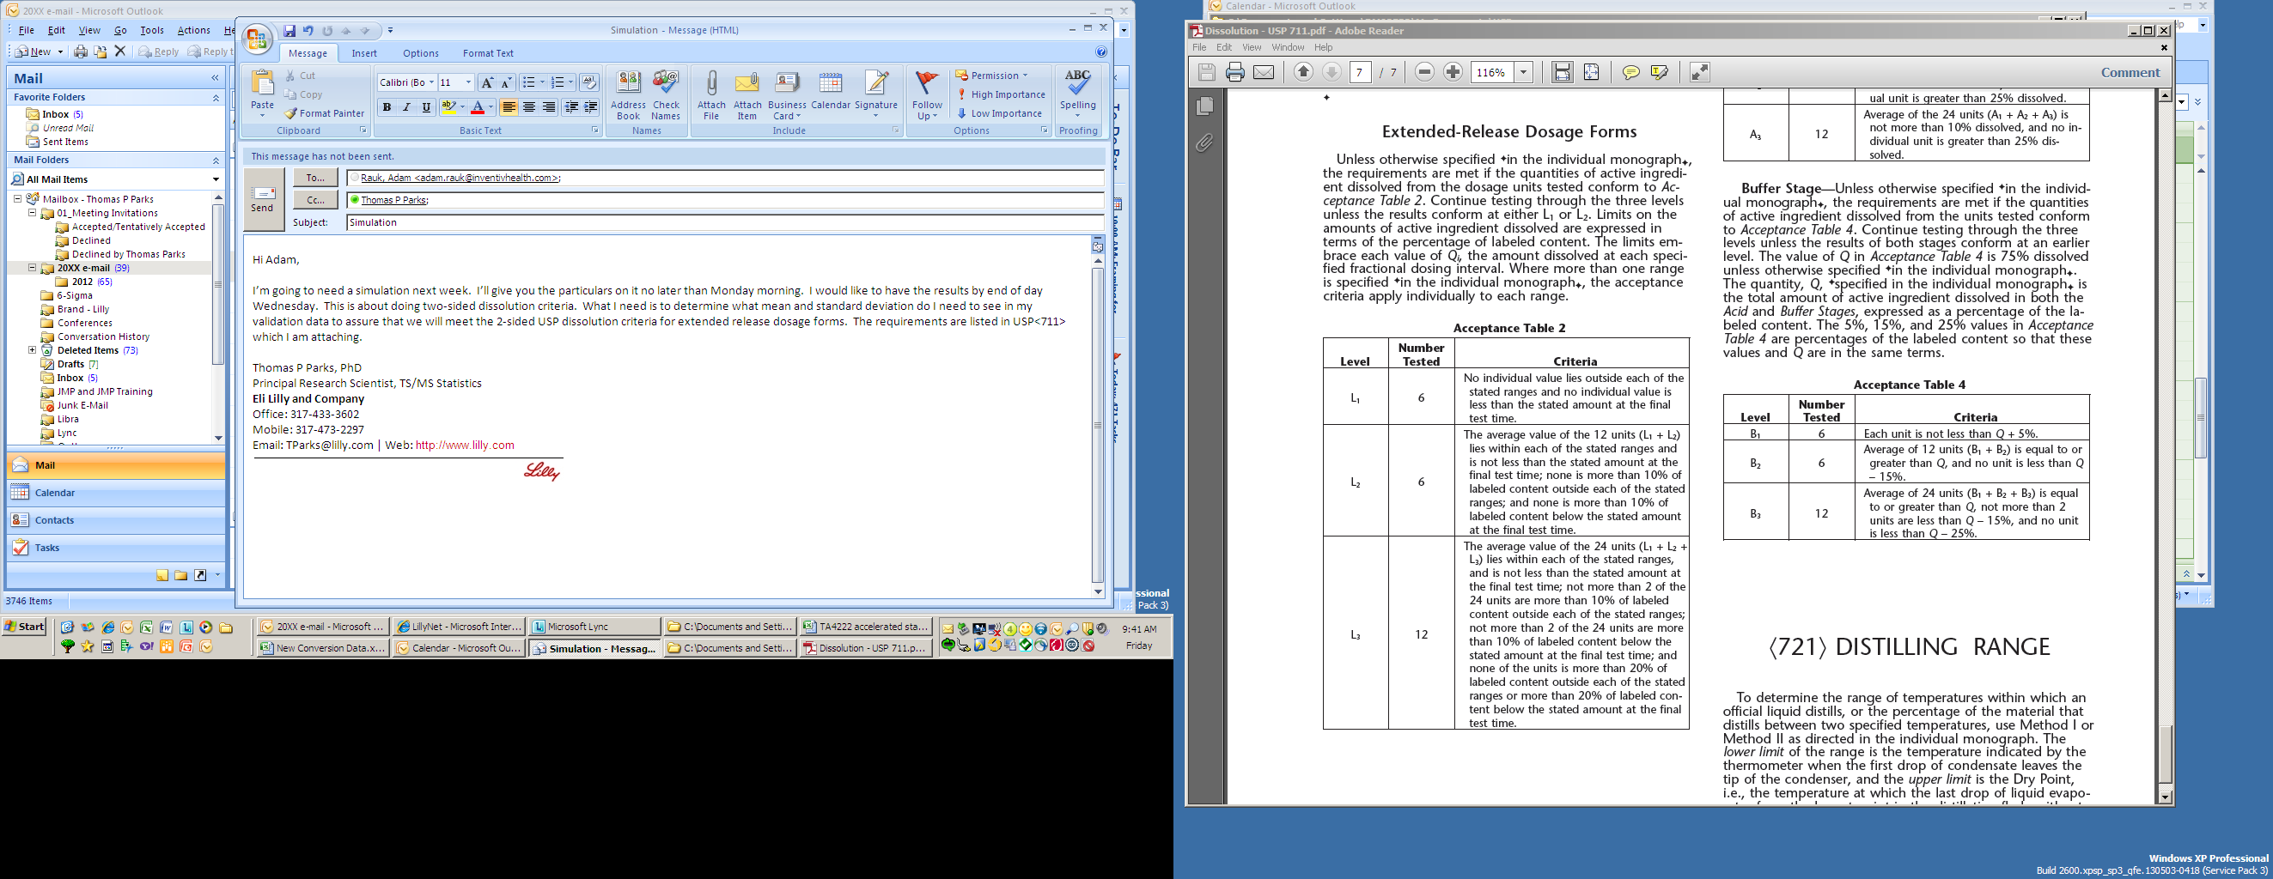
USP <711> Extended Release Test

Slide 7
Extended Release Dissolution Specs at Specified Times
% Released
T₁
T₂
T₃

Slide 8
Validation Criteria – FDA Guidance
FDA 2011 guidance, “Process Validation: General Principles and Practices” states,
  “The number of samples [in the process performance protocol] should be adequate to provide sufficient statistical confidence of quality…”
To provide assurance that the 2-sided dissolution specifications would be met for any other sample pulled randomly from the batch

Slide 9
Extended Release Dissolution Specs and Acceptance Criteria
ASTM E2709, CuDAL
???
% Released
Statistical Criteria Needed to Assure “Confidence”
T₁
T₂
T₃

Slide 10
Problem Statement & Options
Determine acceptance criteria for 2-sided dissolution specifications to provide assurance that future dissolution results will meet the specification limits.
Options
  Implement ASTM E2709 Standard Practice for Demonstrating Capability to Comply with a Lot Acceptance Procedure
    Modify the Validated SAS program CuDAL (Content uniformity and Dissolution Acceptance Limits) to calculate 2-sided limits
  Apply an alternate approach
    A Bayesian approach with simulation

Slide 11
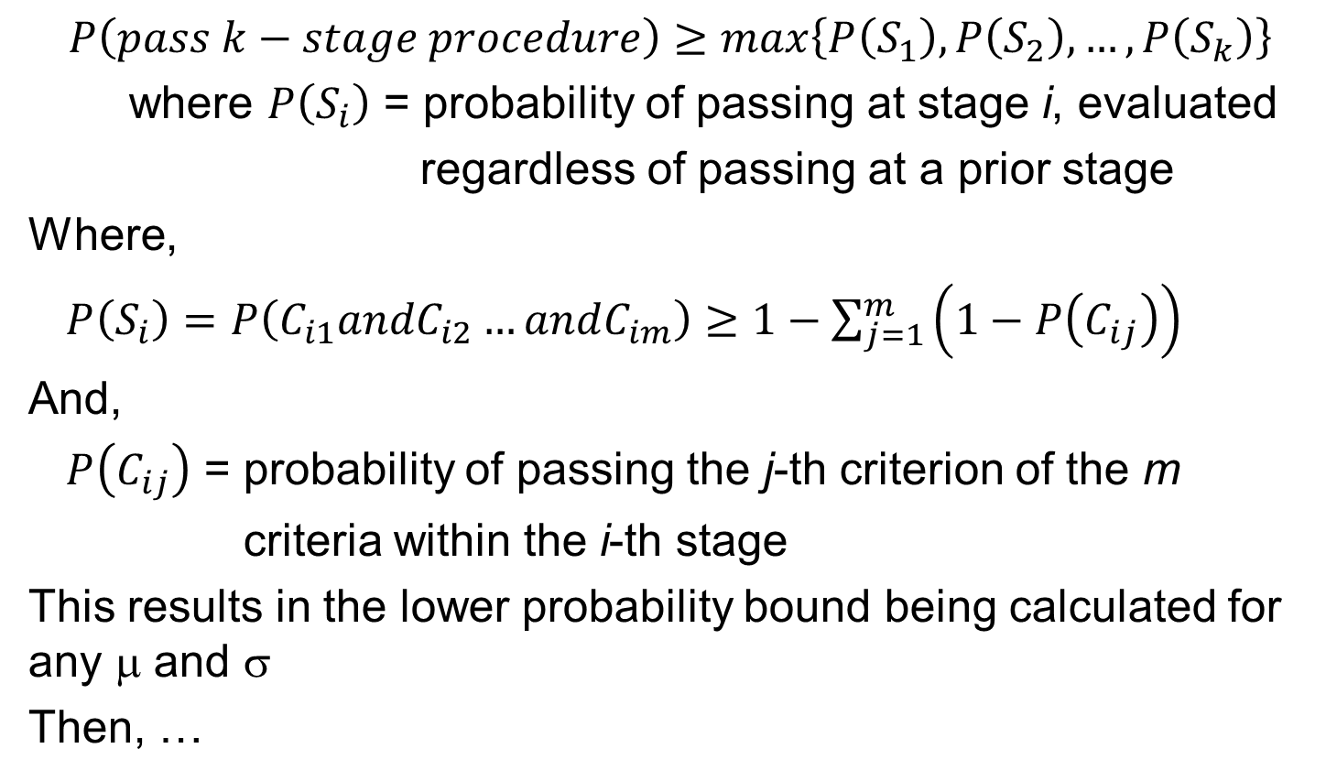
ASTM E2709, Joint Confidence Region
$$P\left(pass k−stage procedure\right)≥max\left\{P\left(S_{1}\right),P\left(S_{2}\right), …,P\left(S_{k}\right)\right\}$$
where $P\left(S_{i}\right)$ = probability of passing at stage i, evaluated
regardless of passing at a prior stage
Where,
$P\left(S_{i}\right)=P\left(C_{i1}andC_{i2}…andC_{im}\right)≥1−\sum_{j=1}^{m}{\left(1−P\left(C_{ij}\right)\right)}$
And,
$P\left(C_{ij}\right)$ = probability of passing the j-th criterion of the m
criteria within the i-th stage
This results in the lower probability bound being calculated for any μ and $$
Then, …

Slide 12
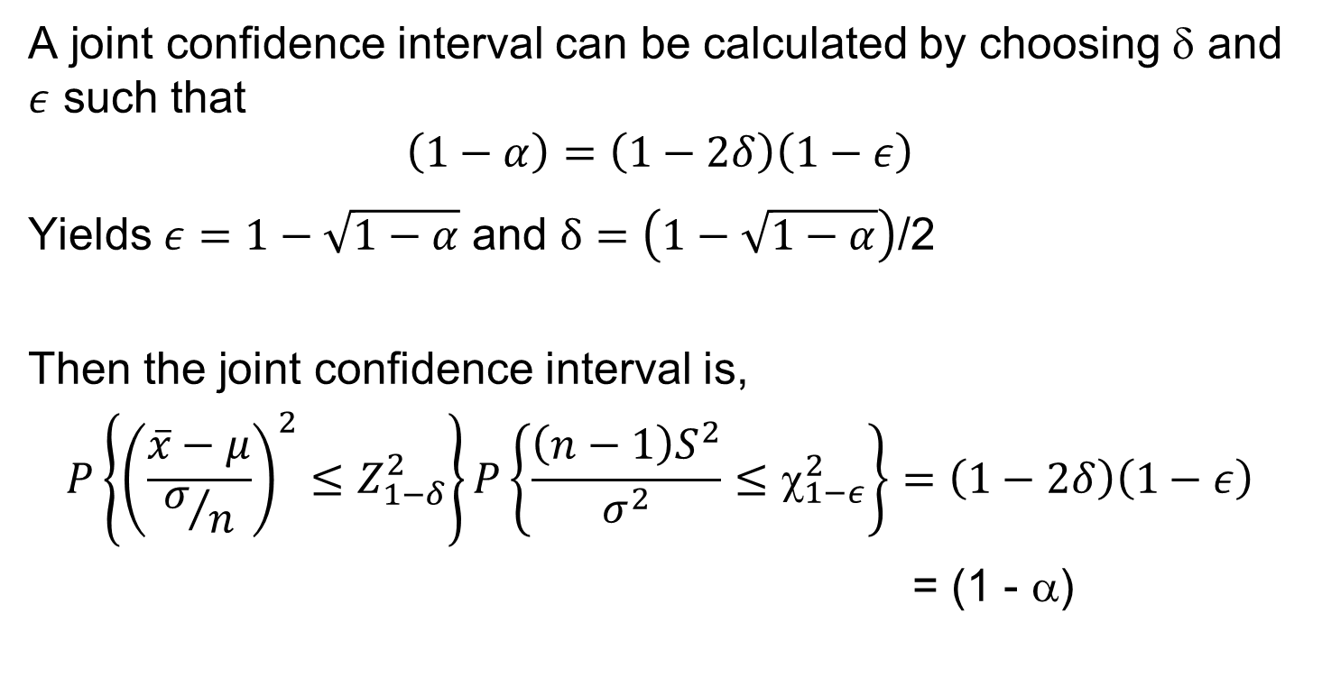
ASTM E2709, Joint Confidence Region
A joint confidence interval can be calculated by choosing δ and $ε$ such that
$$\left(1−α\right)=\left(1−2δ\right)\left(1−ε\right)$$
Yields $ε=1−\sqrt{1−α}$ and $δ=\left(1−\sqrt{1−α}\right)$/2
Then the joint confidence interval is,
$$P\left\{{\left(\frac{\overline{x}−μ}{σ/n}\right)}^{2}≤Z_{1−δ}^{2}\right\}P\left\{\frac{{\left(n−1\right)S}^{2}}{σ^{2}}≤χ_{1−ε}^{2}\right\}=\left(1−2δ\right)\left(1−ε\right)$$
= (1 - α)

Slide 13
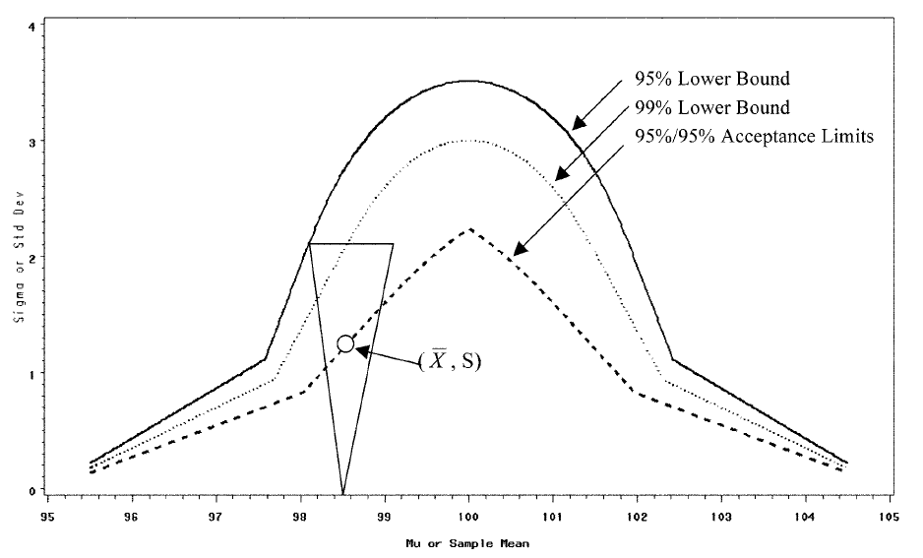

ASTM E2709, Joint Confidence Region from Observed $\overline{X}$ and S

Slide 14
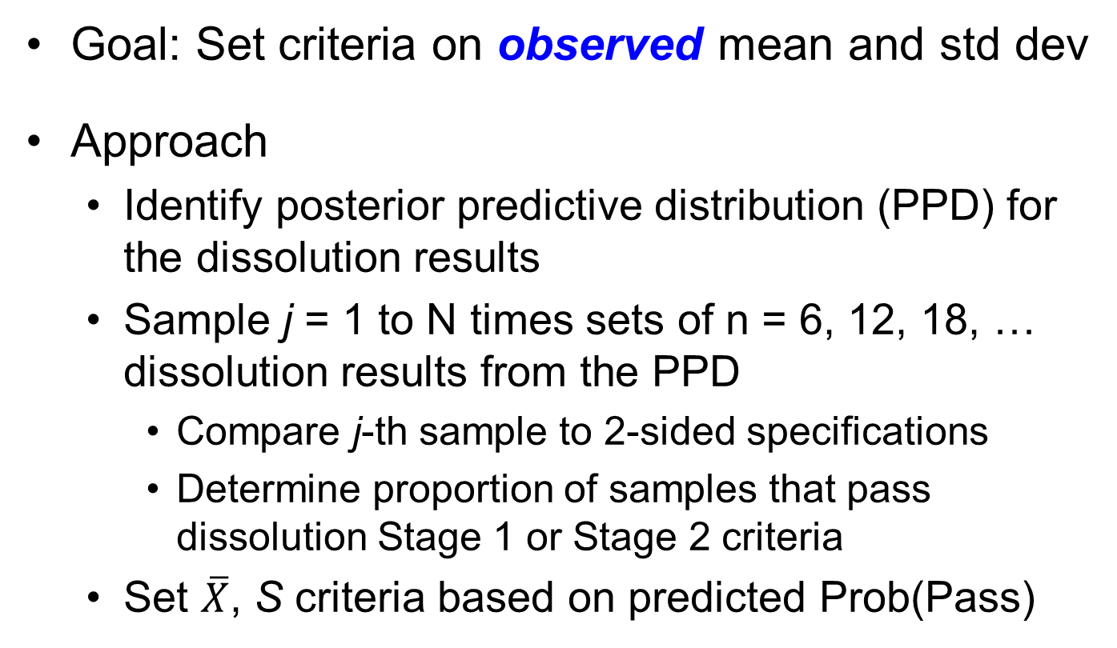
Bayesian 2-sided Dissolution Acceptance Criteria
Goal: Set criteria on observed mean and std dev
Approach
  Identify posterior predictive distribution (PPD) for the dissolution results
  Sample j = 1 to N times sets of n = 6, 12, 18, … dissolution results from the PPD
    Compare j-th sample to 2-sided specifications
    Determine proportion of samples that pass dissolution Stage 1 or Stage 2 criteria
  Set $\overline{X}$, S criteria based on predicted Prob(Pass)

Slide 15
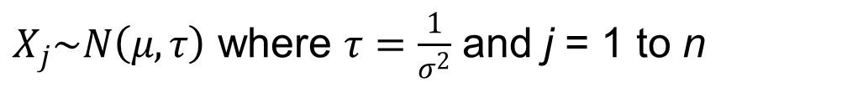
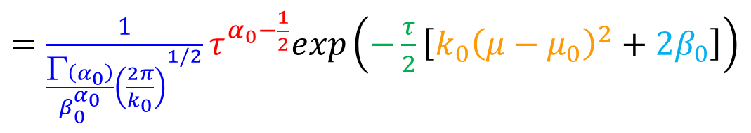
Distributions*
$X_{j}\sim N\left(μ,τ\right)$ where $τ=\frac{1}{σ^{2}}$ and j = 1 to n
Let
Then the likelihood can be written as
$p\left(D|μ,τ\right)=\frac{1}{{\left(2π\right)}^{n/2}}τ^{n/2}exp\left(−\frac{τ}{2}\left[n{\left(μ−\overline{x}\right)}^{2}+\sum_{j=1}^{n}{{\left(x_{j}−\overline{x}\right)}^{2}}\right]\right)$
For unknown μ and τ, a conjugate prior is Normal-Gamma
$$NG\left(μ,τ|μ_{0},k_{0},α_{0}β_{0}\right)≝N\left(μ|μ_{0},{\left(k_{0}τ\right)}^{−1}\right)Ga\left(τ|α_{0},β_{0}\right)$$
$=\frac{1}{{\frac{Γ\left(α_{0}\right)}{β_{0}^{α_{0}}}\left(\frac{2π}{k_{0}}\right)}^{1/2}}τ^{α_{0}−\frac{1}{2}}exp\left(−\frac{τ}{2}\left[k_{0}{\left(μ−μ_{0}\right)}^{2}+2β_{0}\right]\right)$
* K. Murphy, “Conjugate Bayesian analysis of the Gaussian distribution”, 2007

Slide 16
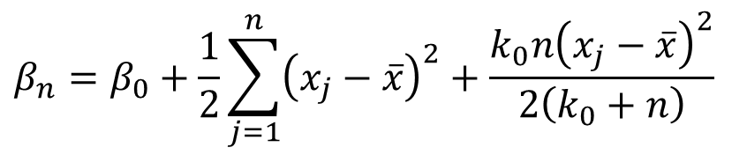



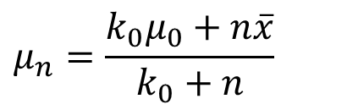
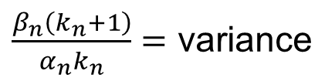
Distributions*
Then the posterior can be written as
$$μ_{n}=\frac{k_{0}μ_{0}+n\overline{x}}{k_{0}+n}$$
$p\left(μ,τ|D\right)=$ $NG\left(μ,τ|μ_{n},k_{n},α_{n}β_{n}\right)$, where
$$β_{n}=β_{0}+\frac{1}{2}\sum_{j=1}^{n}{{\left(x_{j}−\overline{x}\right)}^{2}}+\frac{k_{0}n{\left(x_{j}−\overline{x}\right)}^{2}}{2\left(k_{0}+n\right)}$$
$k_{n}=k_{0}+n$,
$α_{n}=α_{0}+\frac{n}{2}$,
And the posterior predictive distribution is a Student’s t
$p\left(x|D\right)=$ $t_{{2α}_{n}}\left(x|μ_{n},\frac{β_{n}\left(k_{n}+1\right)}{α_{n}k_{n}}\right)$, where
${2α}_{n}=$ degrees freedom, $μ_{n}=$ shifted mean,
$\frac{β_{n}\left(k_{n}+1\right)}{α_{n}k_{n}}=$ variance
* K. Murphy, “Conjugate Bayesian analysis of the Gaussian distribution”, 2007

Slide 17
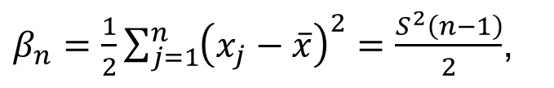


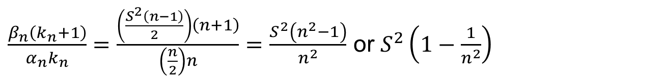

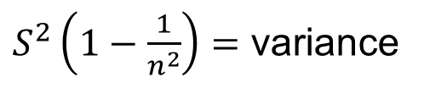
Distributions
If we use a non-informative prior by setting $k_{0}=μ_{0}=α_{0}=β_{0}=0$,
then,
$k_{n}=n$,
$μ_{n}=\overline{x}$,
$α_{n}=\frac{n}{2}$,
$β_{n}=\frac{1}{2}\sum_{j=1}^{n}{{\left(x_{j}−\overline{x}\right)}^{2}}=\frac{S^{2}\left(n−1\right)}{2}$,
and,
$\frac{β_{n}\left(k_{n}+1\right)}{α_{n}k_{n}}=\frac{\left(\frac{S^{2}\left(n−1\right)}{2}\right)\left(n+1\right)}{\left(\frac{n}{2}\right)n}=\frac{S^{2}\left(n^{2}−1\right)}{n^{2}}$ or $S^{2}\left(1−\frac{1}{n^{2}}\right)$
then the posterior predictive distribution is Student’s t
$p\left(x|D\right)=$ $t_{n}\left(x|\overline{x},S^{2}\left(1−\frac{1}{n^{2}}\right)\right)$, where
$n=$ degrees freedom, $\overline{x}=$ shifted mean,
$S^{2}\left(1−\frac{1}{n^{2}}\right)=$ variance

Slide 18
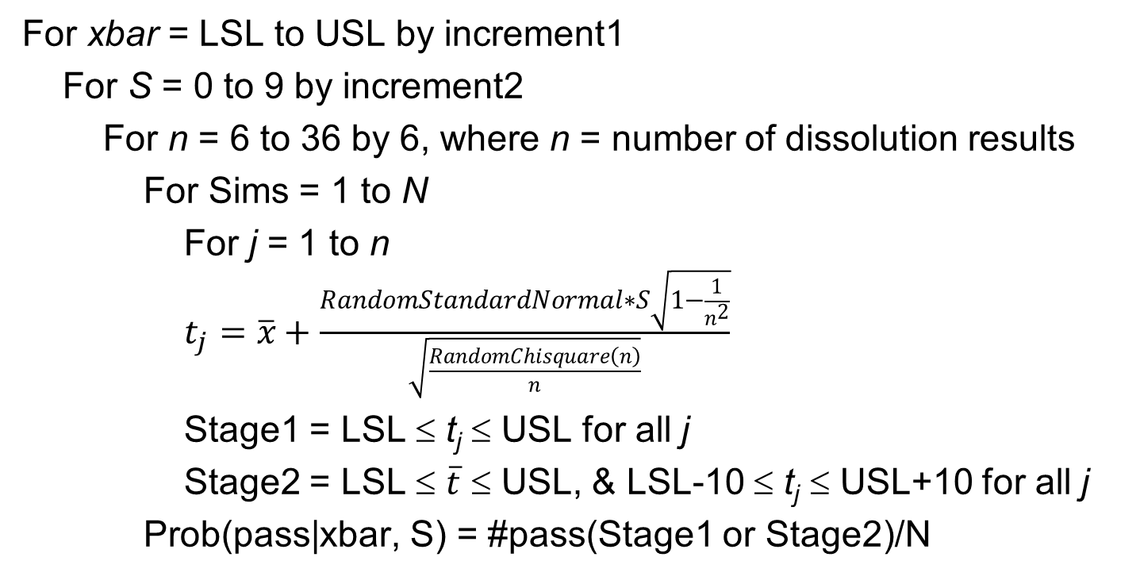
Simulation – Core Routine
For xbar = LSL to USL by increment1
For S = 0 to 9 by increment2
For n = 6 to 36 by 6, where n = number of dissolution results
For Sims = 1 to N
For j = 1 to n
$t_{j}=\overline{x}+\frac{RandomStandardNormal∗S\sqrt{1−\frac{1}{n^{2}}}}{\sqrt{\frac{RandomChisquare\left(n\right)}{n}}}$
Stage1 = LSL ≤ t_{j} ≤ USL for all j
Stage2 = LSL ≤ $\overline{t}$ ≤ USL, & LSL-10 ≤ t_{j} ≤ USL+10 for all j
Prob(pass|xbar, S) = #pass(Stage1 or Stage2)/N

Slide 19
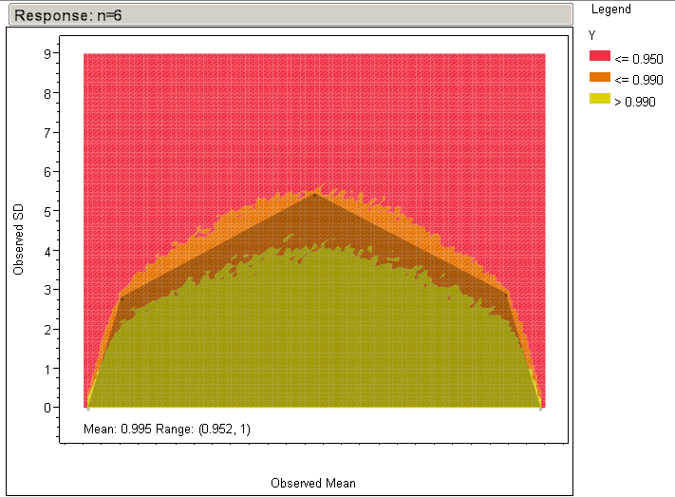
Results

Slide 20
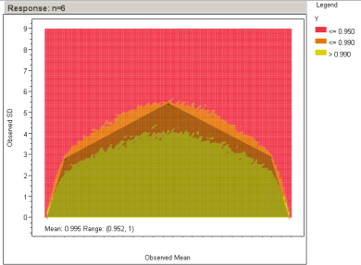
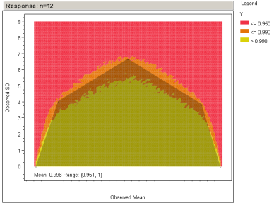
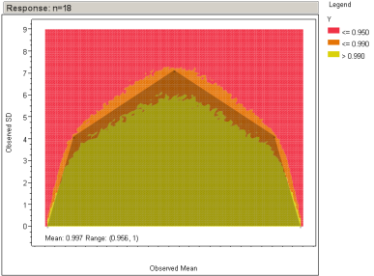
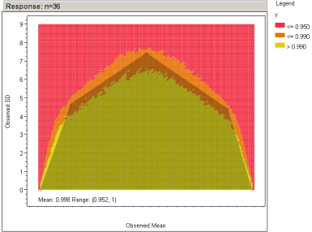
Results

Slide 21
Results – Combined
Over the n of interest (18-36, 3 lots), the selected polygons/acceptance regions are very similar
Reject
Accept

Slide 22
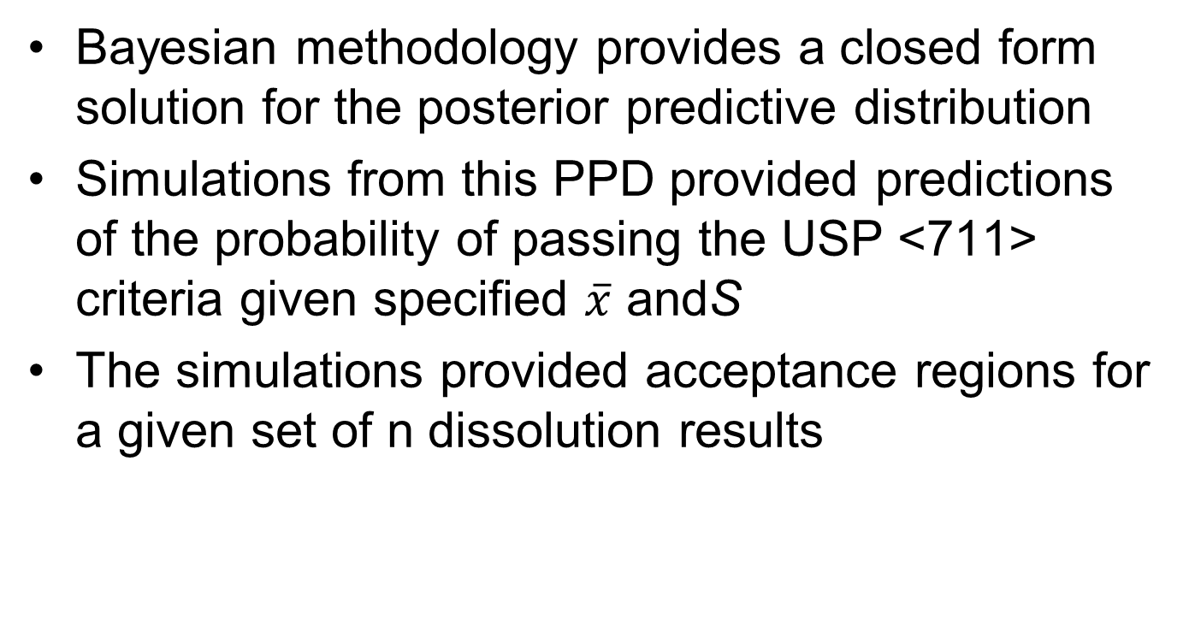
Conclusions
Bayesian methodology provides a closed form solution for the posterior predictive distribution
Simulations from this PPD provided predictions of the probability of passing the USP <711> criteria given specified $\overline{x}$ andS
The simulations provided acceptance regions for a given set of n dissolution results

Slide 23

Comments and Questions

Slide 24
References
http://en.wikipedia.org/wiki/Conjugate_prior
K. Murphy, “Conjugate Bayesian Analysis of the Gaussian Distribution”, 2007
United States Pharmacopeia general chapter <711>
ASTM E2709, “
M. Evans, et. al., “Statistical Distributions” 2nd ed., 1993
N. Johnson, et. al., “Continuous Univariate Distributions” vol 2, 2nd ed., 1995

