Slide 1
Statistical modeling of tumor regrowth experiment in xenograft studies
Cong Li, Greg Hather, Ray Liu
May 18th
MBSW 2016

Slide 2
Tumor xenograft study
Lead discovery/In-vitro study
In-vivo study
Clinical trial
A (rough) diagram of drug development process

Slide 3
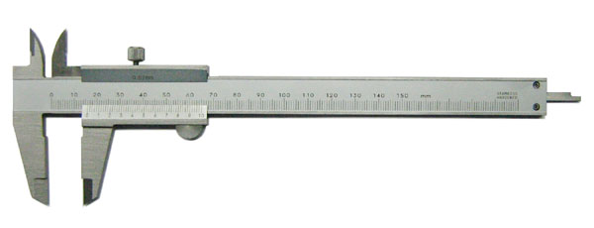
Tumor xenograft study
Tumor sizes are measured over time using a caliper
Tumor size change allows us to characterize in-vivo drug efficacy
Drug combination can also be studied to investigate synergistic effect

Slide 4
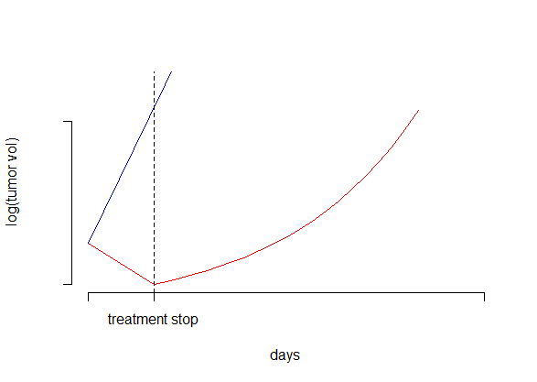
Tumor xenograft study
Typically, drugs are administrated only for a short period of time (10~30 days)
Tumor sizes are measured over time until they reach certain cutoff (the mouse is sacrificed for humane considerations)
red: treatment arm
blue: control arm
Question:
Should we use all the data or only the data up to the time treatment stop?
Note: tumor volumes are usually analyzed in log scale due to the multiplicative nature of tumor cells

Slide 5
Tumor xenograft study
Answer: it depends
Key consideration
Is there sustained treatment effect?
Modeling sustained treatment effect potentially allows us to
reduce the variability of our estimate of treatment effect
detect things that would be missed if ignoring the post-treatment data

Slide 6
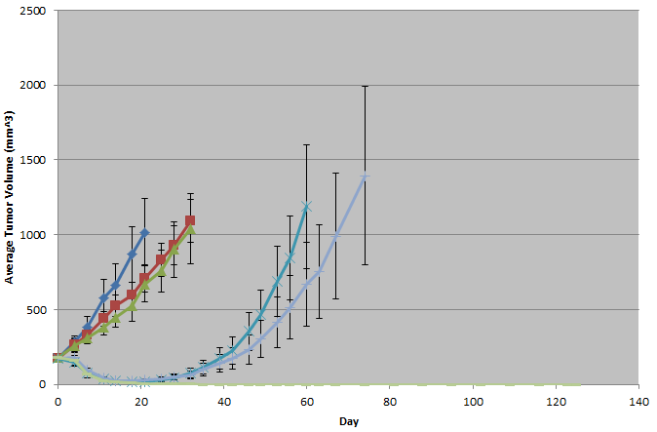
Tumor xenograft study
Trt A, dose 1
Trt A, dose 2
Ctrl
A (dose 1) + B
Trt B
A (dose 2) + B
Day 11
If we only analyze data up to day 11, the synergistic effect between A (especially dose 2) and B cannot be detected

Slide 7
Tumor xenograft study
How to deal with a tumor size that is ‘zero’?
More generally, how to deal with a ‘small’ tumor volume? (assuming measurements below a certain cutoff is inaccurate)

Slide 8
Modeling sustained treatment effect
Exponential decay
$b\left(t\right)= \left\{\begin{aligned} 1 if t ≤t′ \\ \exp\left(−α\left(t−t^{′}\right)\right), if t>t′\end{aligned}\right.$
treatment
Y_{ijt} = Y_{ij0} + f₀(t) + β_{i} x f_{i}(t) + e_{ijt}
Y_{ijt} is the log tumor volume of the j-th animal in the i-th treatment group at t-th day (Y_{ij0} is the initial log volume)
f₀(t) corresponds to the intrinsic tumor growth, f₀(t) = µ_{C} x t
f_{i}(t) corresponds to the treatment effect in the i-th treatment group, $\text{f}\text{i}\text{(}\text{t}\text{) =}\int_{0}^{t}{bi\left(τ\right)dτ}$

Slide 9
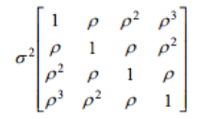
Modeling autocorrelation
Note that autocorrelation exists for the tumor sizes within a mouse
We use the following autoregressive structure to capture the autocorrelation
suppose there are only four observations (three different days) for each mouse
e_{ij} ~ N(0, )

Slide 10
Modeling small tumor sizes
Two ‘quick and dirty’ solutions
Truncate small tumor volumes at the cutoff
Discard small volumes as missing
A better solution
Treat small volumes as censored

Slide 11
The algorithm
The challenge
The censored log likelihood for a mouse involves CDF of a m-dimensional multivariate Gaussian distribution
m is the number of points that are censored
A HUGE computational obstacle when m gets large
Fang et al (2014) proposed an EM algorithm to fit a similar model
However, it does not solve the problem; the E-step is still very computationally challenging
Finding the expectation of a truncated multivariate Gaussian distribution is not trivial; often involves Monte Carlo simulations
Fang et al. Modeling sustained treatment effects in tumor xenograft experiments. 2014. Journal of Biopharmaceutical Statistics.

Slide 12
Our solution
In time series analysis, it is well known that the ordinary least square (OLS) is still unbiased regardless of the autocorrelation
Consequences ignoring the autocorrelation
Treatment effect estimate: unbiased
May lose a little efficiency
Residual variance estimate: biased
Inference of treatment effect: incorrect
These observations motivate the following strategy

Slide 13
Our solution
Data_{trt}
Data_{ctrl}
Control arm usually has no censoring;
therefore autocorrelation can be estimated
Ignore autocorr
β₀, β, α
σ², ρ
Parametric bootstrap
C.I. of [β₀, β, α]

Slide 14
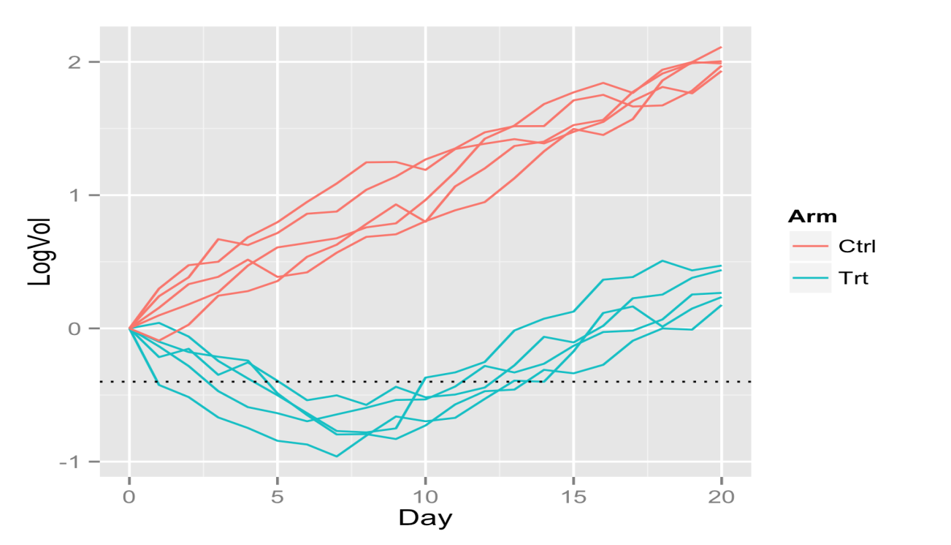
Simulation experiment
N = 5 for both treatment and control arms
Tumor sizes are measured daily from day 0 to day 20
Treatment stopped at day 6
β = -0.2; β₀ = 0.1
α = 0.5; ρ = 0.9; σ = 0.2
Baseline volume = 1 (0 after log transformation)
Censoring cutoff = -0.4

Slide 15
Simulation experiment
We compared our approach (a) with two other naïve approaches
Discard data after day 6, censoring is modeled (b)
Discard data after day 6, tumor volumes below -0.4 are also discarded (c); note that in this case autocorrelation can be modeled as there are no censoring
500 repeats were simulated
Approach
Growth inhibition rate (GRI)
Approach | β mean (truth = -0.2) | β s.d. | α median (truth = 0.5) | α s.d.
a | -0.2007 | 0.0230 | 0.4974 | 0.8163
b | -0.1981 | 0.0349 | N/A | N/A
c | -0.1813 | 0.0245 | N/A | N/A
approach c is biased, approach b has large standard error

Slide 16
Simulation experiment
We also evaluated the confidence interval we obtained from the parametric bootstrap
In 384(76.8%) out of the 500 repeats, the estimated 80% C.I. covers the true value
The gap may be due to the bias of Maximum Likelihood Estimate (MLE) of residual variance (can be fixed by using REML)
We also did simulation to investigate how much efficiency is lost due to ignoring the autocorrelation
We set the censoring cutoff to –Inf and compare two approaches (account for autocorrelation v.s. ignore autocorrelation)
s.d. : 0.0152 v.s. 0.0171

Slide 17
Detection of interaction effect
When i-th group receives the combination of treatment 1 and 2
Y_{ijt} = Y_{ij0} + f₀(t) + β₁ x f₁(t) + β₂ x f₂(t) + β_{1x2} x f_{1x2}(t) + e_{ijt}
β₁ and β₂ are the effect of treatment 1 and 2 alone, respectively
$\text{f}\text{1}\text{x}\text{2(}\text{t}\text{) =}\int_{0}^{t}{b1\left(τ\right)b2\left(τ\right)dτ}$
β_{1x2} needs to be estimated to determine if synergistic effect exists between treatment 1 and 2
β_{1x2} significantly smaller than zero suggests synergy;
whereas β_{1x2} significantly larger than zero suggests antagonistic or sub-additive effect

Slide 18
Detection of interaction effect
Trt A, dose 1
Trt A, dose 2
Ctrl
A (dose 1) + B
Trt B
A (dose 2) + B
Day 11
We compared two approaches on this data set:
a. Our approach
b. Discard data after day 11

Slide 19
Real data example
Approach a
Treatment | Growth inhibition rate | 95% Confidence Interval | P value | Effect Decay Rate
Trt A, dose 1 | 35% | (25.1%, 47.2%) | 3.45e-18 | 0.0234
Trt A, dose 2 | 41.2% | (30.1%, 56.5%) | 0 | 0.0217
Trt B | 324% | (234%, 419%) | 0 | 0.0857
Approach b
Treatment | Growth inhibition rate | 95% Confidence Interval | P value | Effect Decay Rate
Trt A, dose 1 | 19.6% | (3.69%, 31.8%) | 0.0133 | N/A
Trt A, dose 2 | 33.6% | (18.5%, 47.4%) | 2.28e-17 | N/A
Trt B | 228% | (191%, 269%) | 0 | N/A
Growth inhibition rate is the normalized treatment effect: -β/β₀ x 100%

Slide 20
Real data example
Approach a
Combo | Synergistic Score | 95% Confidence Interval | P value | Assessment
Trt A (dose 1) + Trt B | 1.57% | (-63.7%, 71.1%) | 0.489 | Add.
Trt A (dose 2) + Trt B | 348% | (184%, 565%) | 1.28e-18 | Syn.
Approach b
Combo | Synergistic Score | 95% Confidence Interval | P value | Assessment
Trt A (dose 1) + Trt B | -31.7% | (-76.4%, 16.5%) | 0.088 | Add.
Trt A (dose 2) + Trt B | 8.41% | (-42.5%, 63.8%) | 0.388 | Add.
Synergistic score is the normalized interaction effect: -β_{1x2}/β₀ x 100%

Slide 21
Discussion
Post-treatment data should be included in analysis if there is sustained treatment effect
Gain information (reduce standard error)
Detect post-treatment synergistic effect
We have developed a framework to analyze tumor xenograft experiment data while accounting for autocorrelation and censoring
We bypassed a challenging computational obstacle by a carefully designed parametric bootstrap procedure

Slide 22
Acknowledgement
Colleagues from Cancer Pharmacology at Takeda Boston

Slide 23
Thank you

