Slide 1
Setting Release Limits: A comparison of Frequentist and Bayesian Approaches
Niels Væver Hartvig PhD
Principal Specialist, Novo Nordisk A/S
THE 39th ANNUAL MIDWEST BIOPHARMACEUTICAL STATISTICS WORKSHOP
MAY 16–18, 2016, MUNCIE, INDIANA

Slide 2
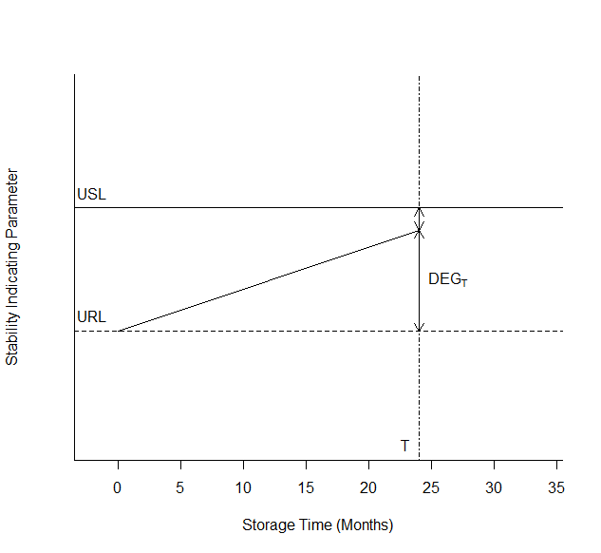
Definitions & Terminology
Shelf life limit (SL): Registered specification limit which the product must conform to until expiry.
Release limit (RL): Internal release limit that is used to provide confidence that a released batch complies with the shelf life limit until expiry
Shelf life (T)
All data and specification limits are constructed for illustration of principles

Slide 3
Outline of talk: Setting internal release limits
Frequentist approach: Allen, Dukes and Gerger (1991)
Bayesian approach: Wei (1998)
Comparison of methods and recommendations
P.V. Allen, G.R. Dukes, M.E. Gerger (1991) “Determination of release limits: A General Methodology”, Pharm. Research, 8 (9)
G.C.G. Wei (1998) ”Simple methods for determination of the release limits for drug products”, J. Biopharm. Statist., 8 (1)

Slide 4
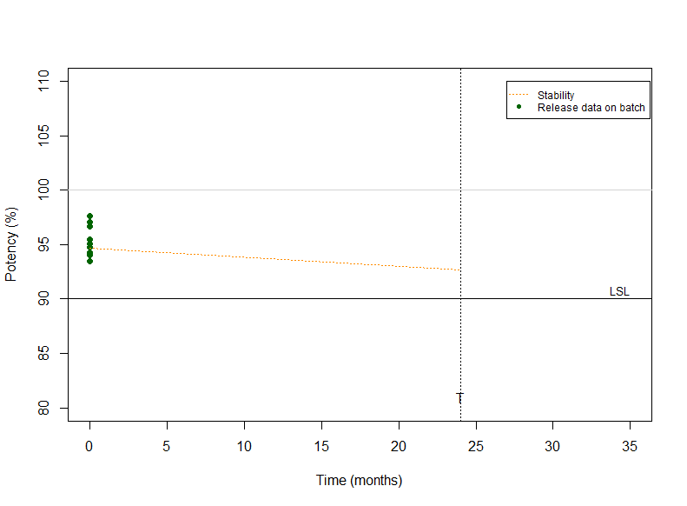
Allen, Dukes & Gerger (1991)
Linear regression model for stability limiting parameter of actual batch:
Estimated common rate of change from historical data:
or
Estimated batch level at time T
Release batch if 95% CL is above LSL

Slide 5
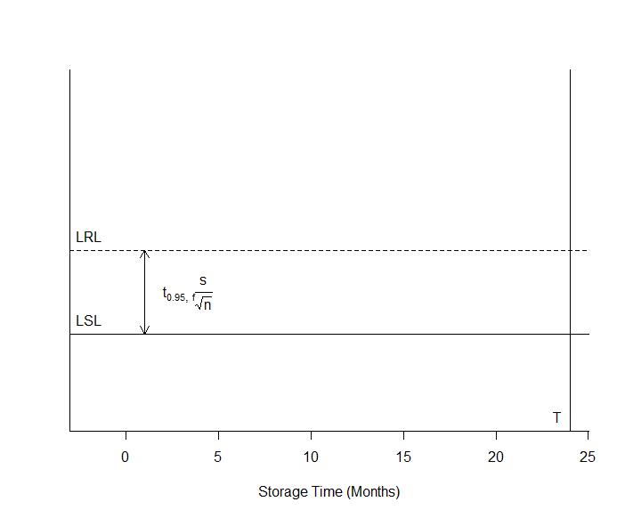
Example: Only analytical uncertainty
Intermediate precision of analytical method
Quantile, typically ~ 1.65 for 95% confidence.
Number of independent results at release.

Slide 6
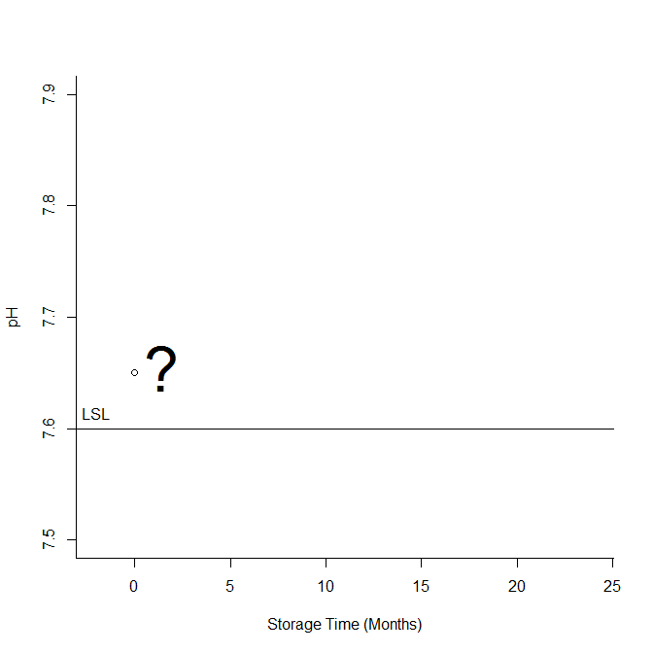
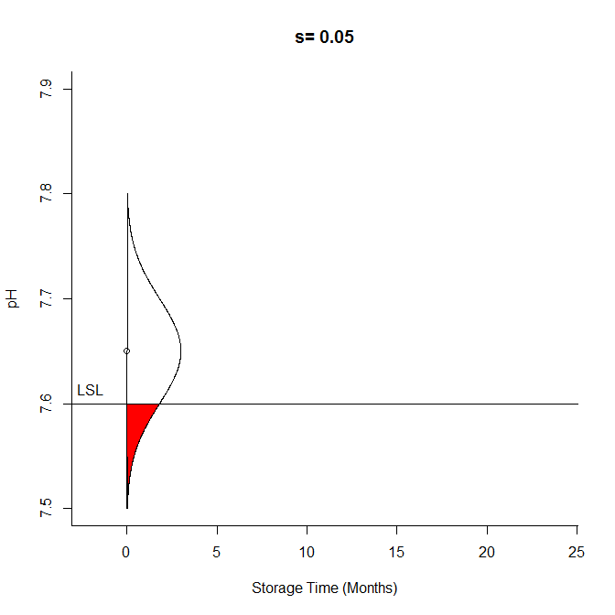
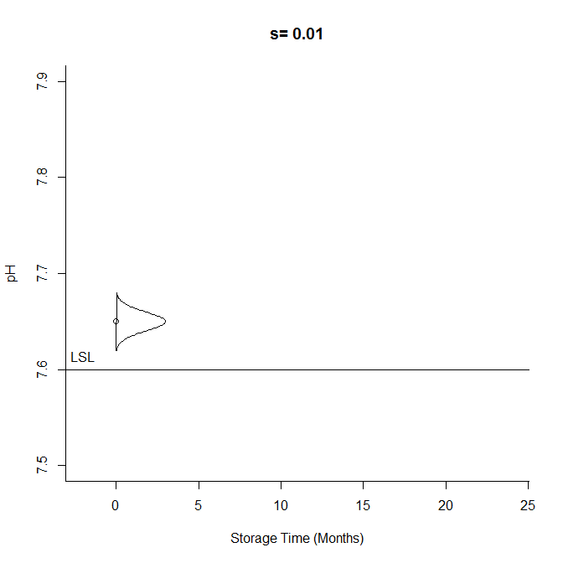
How much can we trust the release result?

Slide 7
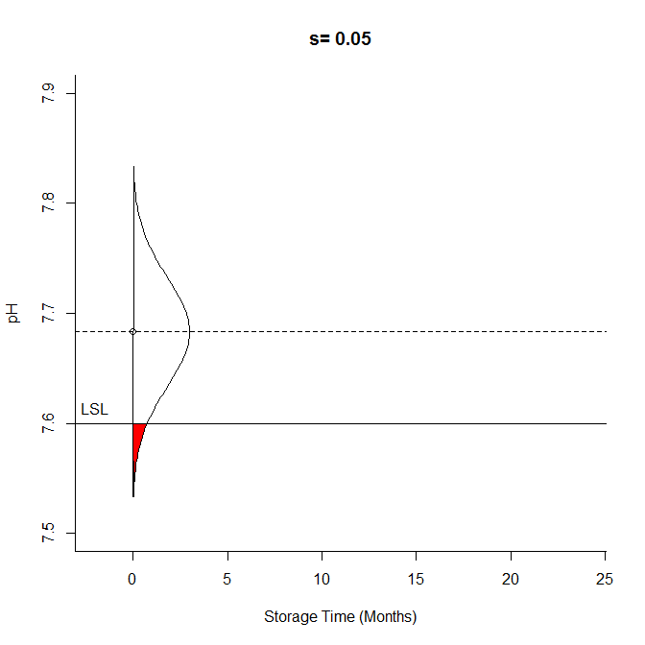
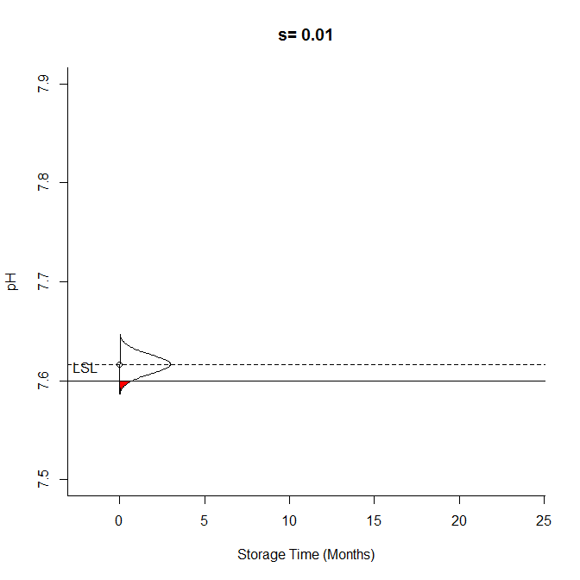
Release limit ensures 95% confidence
If a release result is exactly at the release limit, we have 95% confidence that the batch is within LSL throughout shelf life

Slide 8
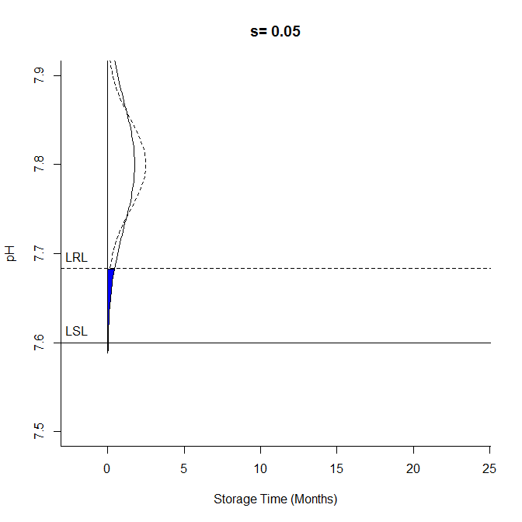
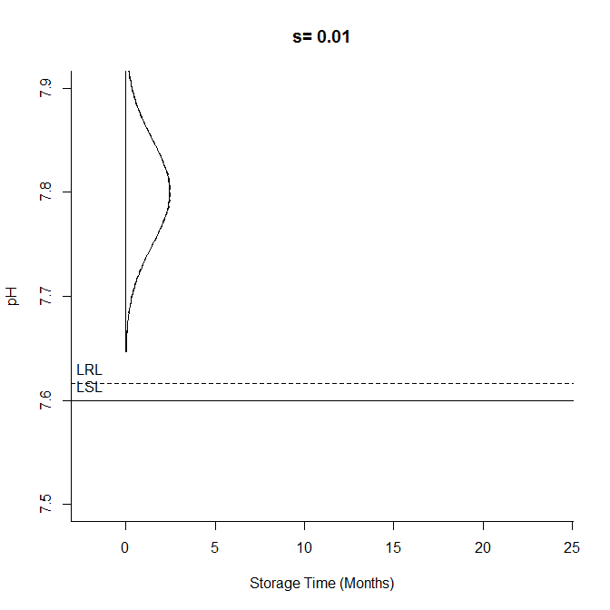
Impact of analytical variation
Target: 7.8
Process SD = 0.05
Analytical variation hurts twice:
1. Tighter release limits needed
2. More variation in release results

Slide 9
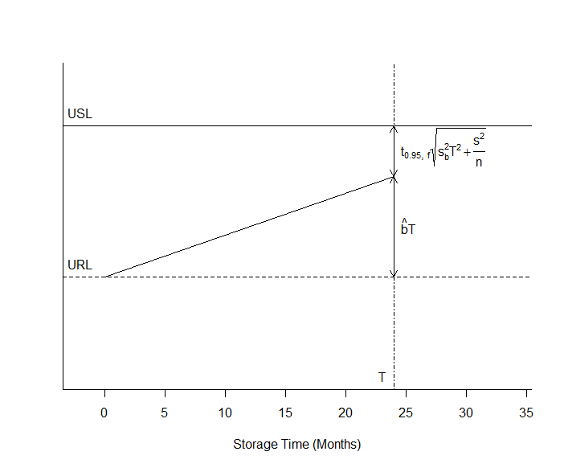
Example: Stability degradation
Estimated degradation during shelf life
Uncertainty of estimated degradation

Slide 10
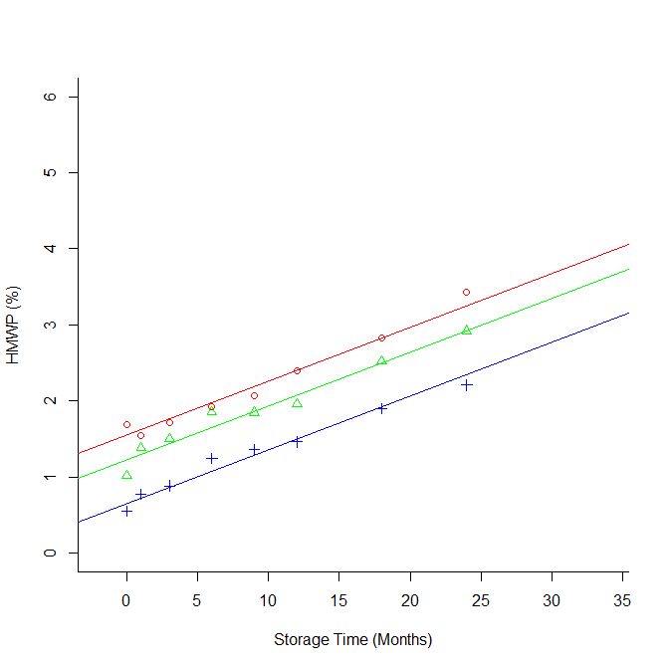
Degradation rate estimated from historical data
b is the common degradation rate for all batches.
Degradation rates for different batches cannot be different!

Slide 11
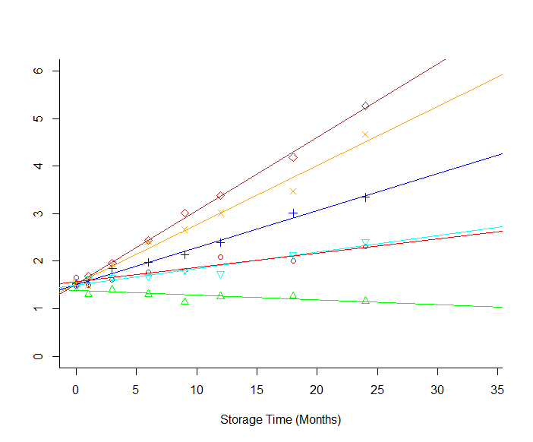
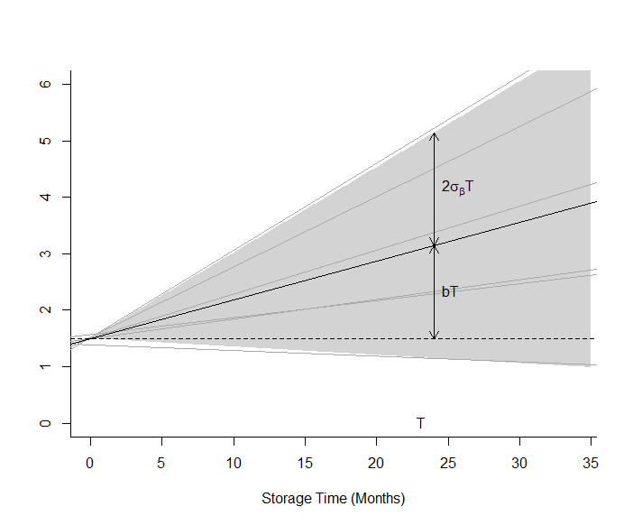
What if batches are not similar?
Mixed model with random slope:

Slide 12
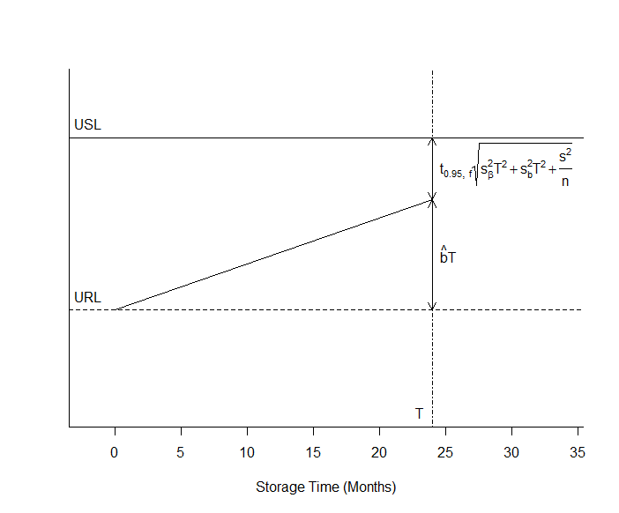
Extension to random batch-slope
Batch-slope variance

Slide 13
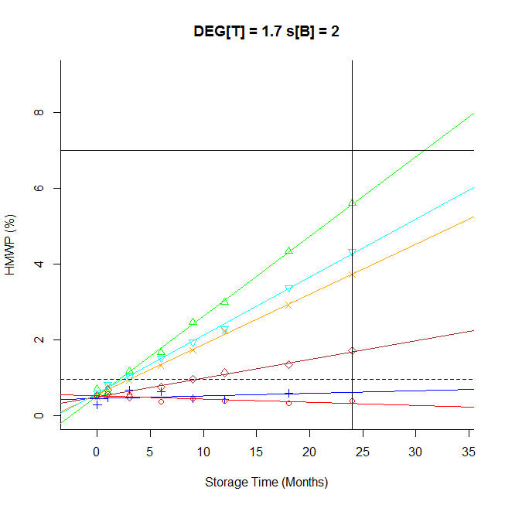
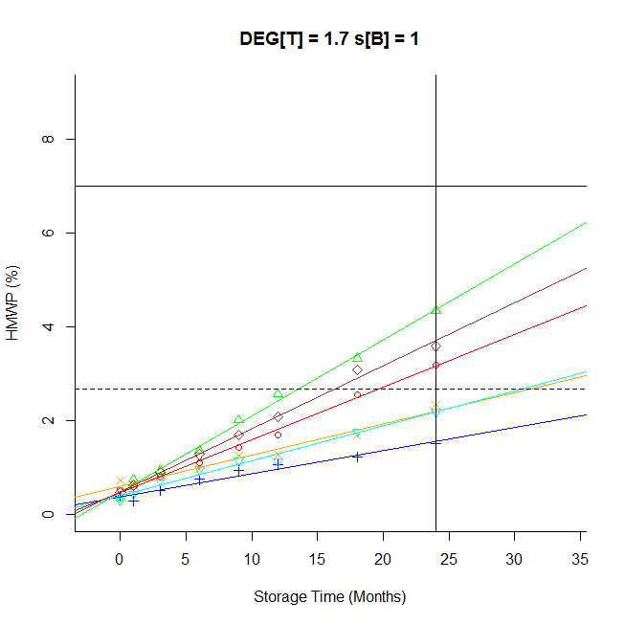
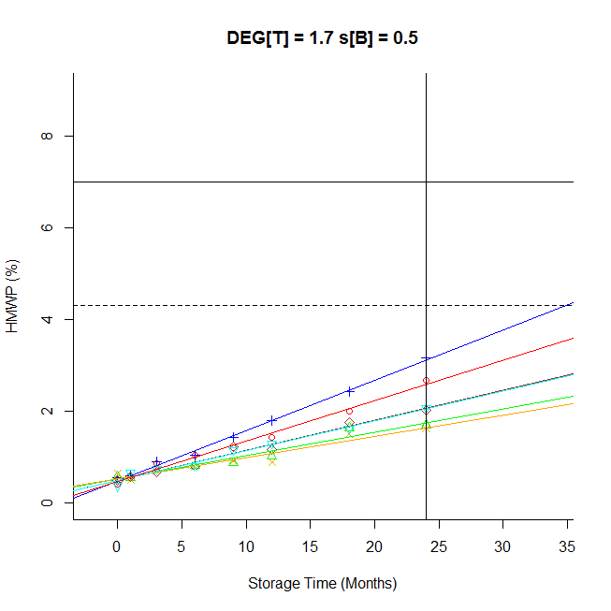
Examples of variation between batches
Batch-to-batch variation narrows release limits

Slide 14
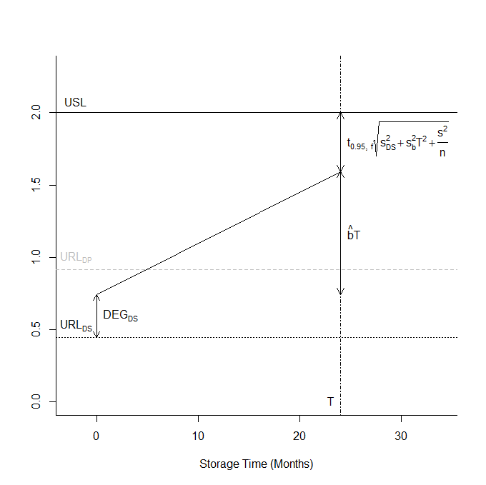
Combined specifications: DS & DP
DS internal release limit (combined confidence)
DS degradation during storage and formulation
Uncertainty of DS degradation
Internal release limit for DS ensures with high confidence that DP will comply with USL, but not that DP will comply with internal release limit!

Slide 15
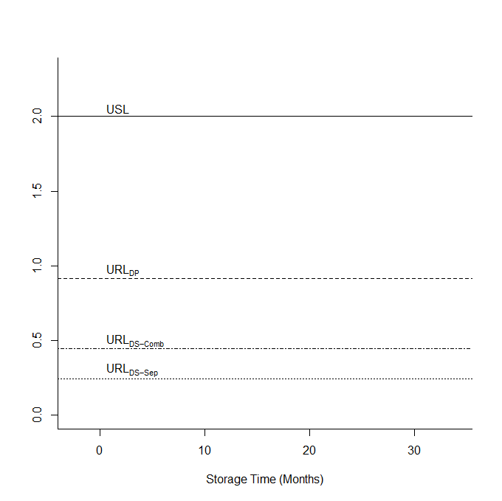
Separate confidence for each test instance
Statistical confidence for each test instance narrows release limits

Slide 16
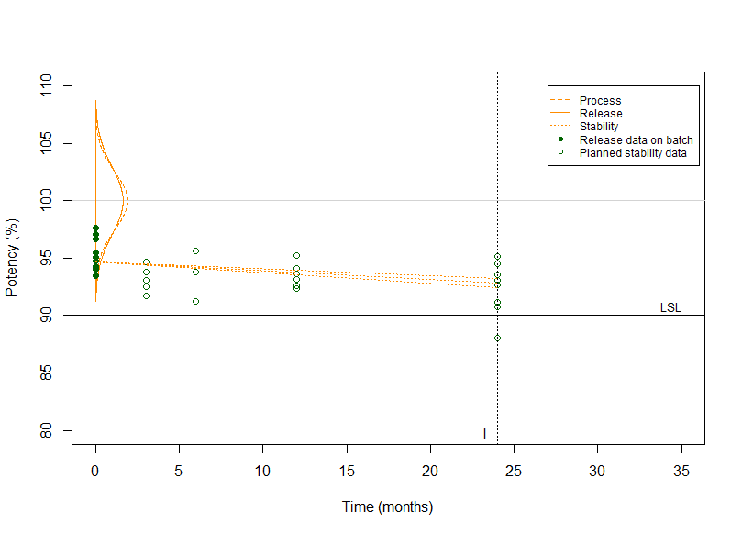
Wei (1998)
Release and stability data on actual batch:
Historical data:
or
Least-squares estimate of batch level based on data available at time T
Conditional distribution used for release:
*A conditional least-squares estimate is used in the paper

Slide 17
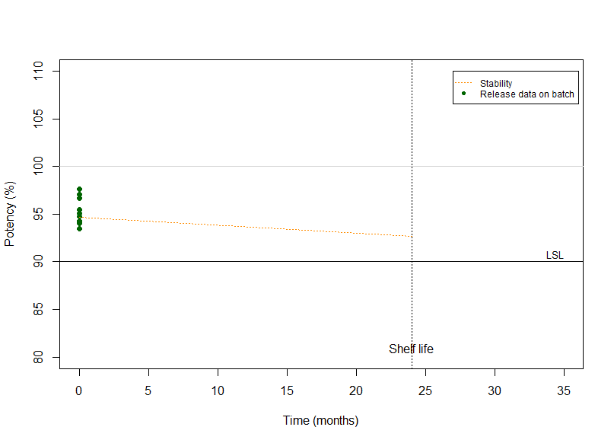
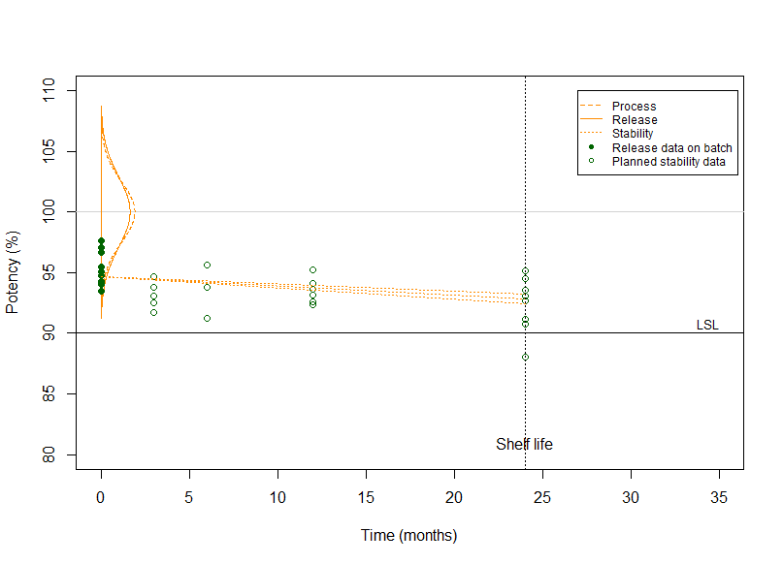
Wei’s release limit depends on test plan for batch
ADG
Wei
Release data
Release and future stability data
To compare the two approaches, we consider the Wei method assuming only release data for a batch.

Slide 18
Wei’s two principles
Conditional limits (ADG’s principle)
Conditionally on a release result from a batch, ensures that this batch remains within spec with high confidence, based only on historical stability estimate and the release result.
Unconditional limits
Ensures that for the population of batches as a whole we will have low risk of OOS, by combining the knowledge obtained from the release result with the assumption that the process has only been subject to normal random variation.

Slide 19
Predicted mean at EOS based on release data
Conditional principle (ADG):
Unconditional principle:

Slide 20
Illustration of P(μ_{iT}|Y_{i0})
Conditional principle (ADG):
Unconditional principle:
The following slides illustrate the difference in the distribution P(μ_{iT}|Y_{i0}) in the conditional principle and unconditional principle

Slide 21
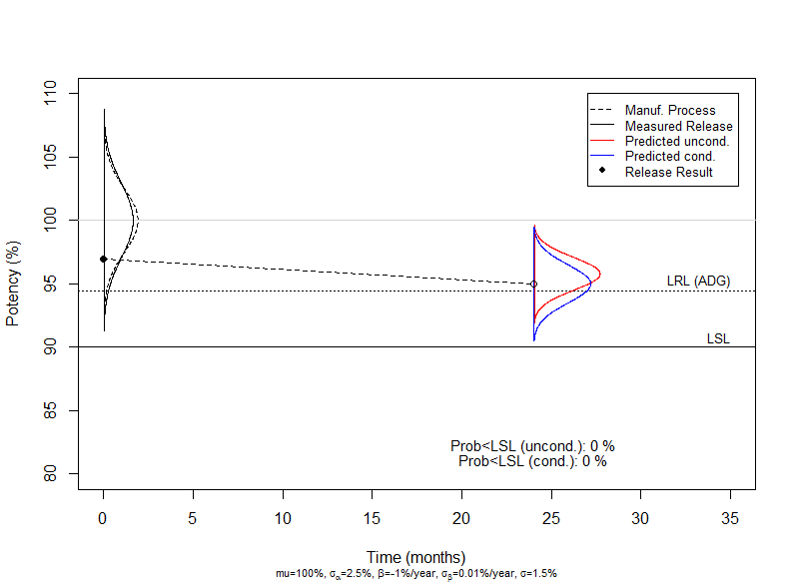
Illustration of P(μ_{iT}|Y_{i0})
The unconditional method uses the normal distribution of the manufacturing process to bias the mean towards the historical mean

Slide 22
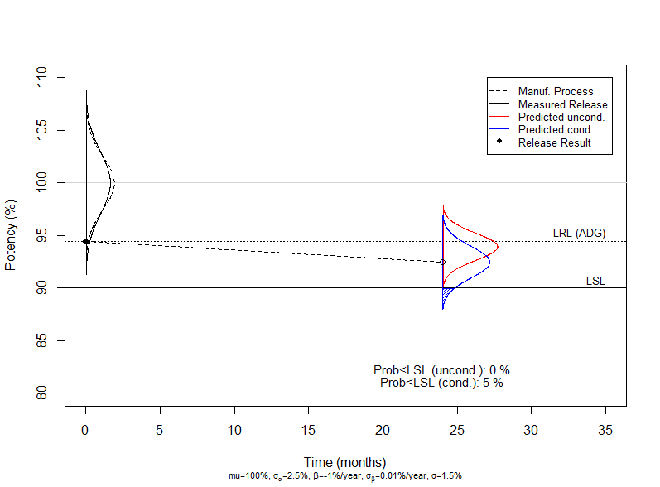
Illustration of P(μ_{iT}|Y_{i0})
When the release result is at the ADG-release limit there is 5% chance that the mean is outside LSL at time T in the conditional method.
In the unconditional method, the risk is much lower.

Slide 23
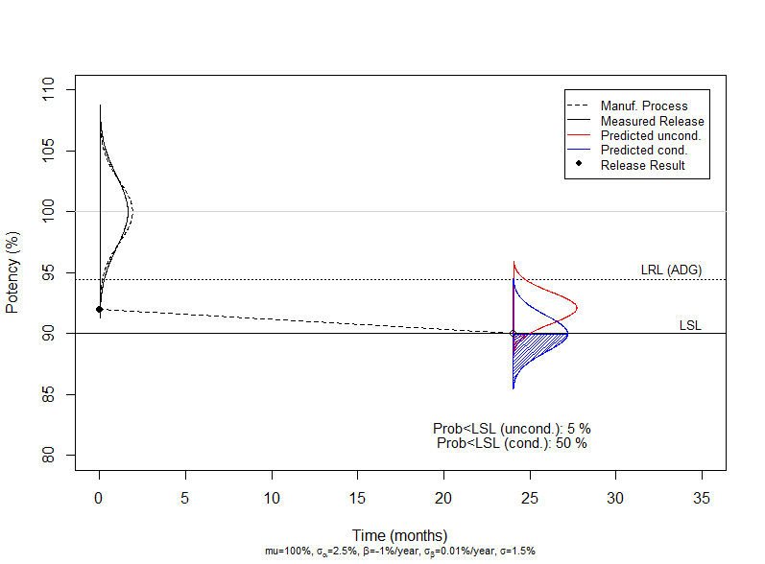
Illustration of P(μ_{iT}|Y_{i0})
When the risk in the unconditional density is 5%, the conditional density is much higher – here 50%.

Slide 24
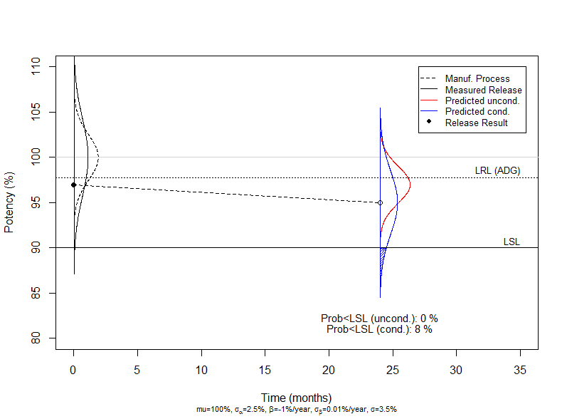
Illustration of P(μ_{iT}|Y_{i0})
When the measurement uncertainty is high, the conditional method is more conservative and the unconditional even more biased towards the historical mean.

Slide 25
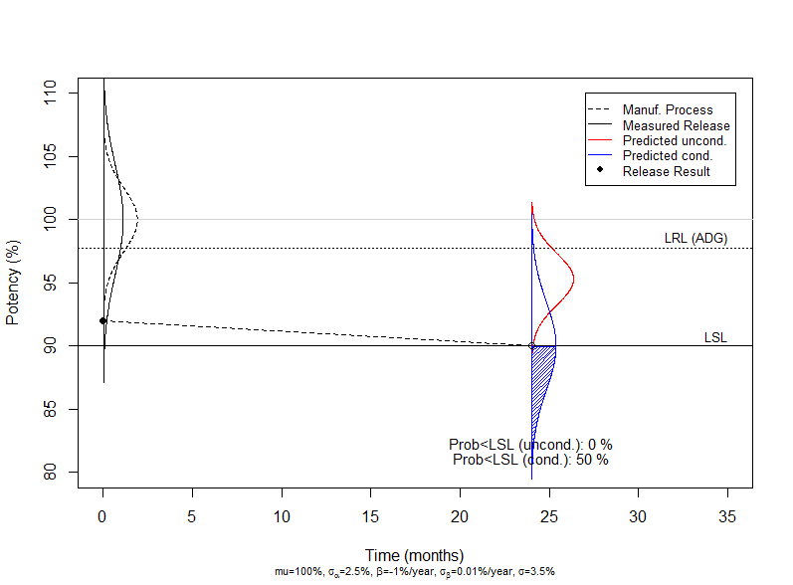
Illustration of P(μ_{iT}|Y_{i0})
Even when the risk is 50% for the conditional method, the risk is virtually 0 for the unconditional.

Slide 26
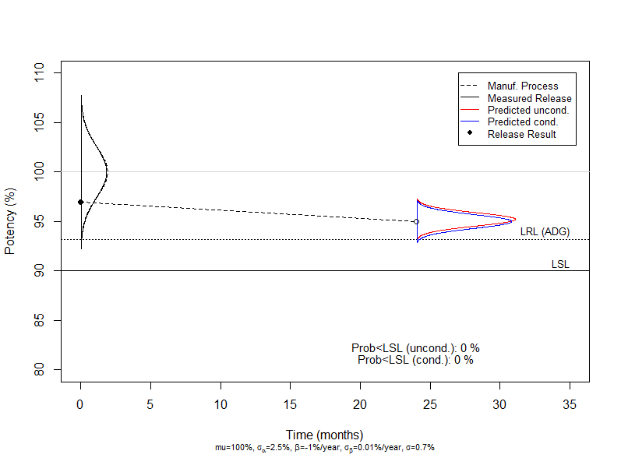
Illustration of P(μ_{iT}|Y_{i0})
When measurement error is low – the two distributions are very similar.

Slide 27
Illustration of risk controlled
Conditional principle (ADG):
Unconditional principle:
The following slide illustrates the difference in the risk controlled by the two methods

Slide 28
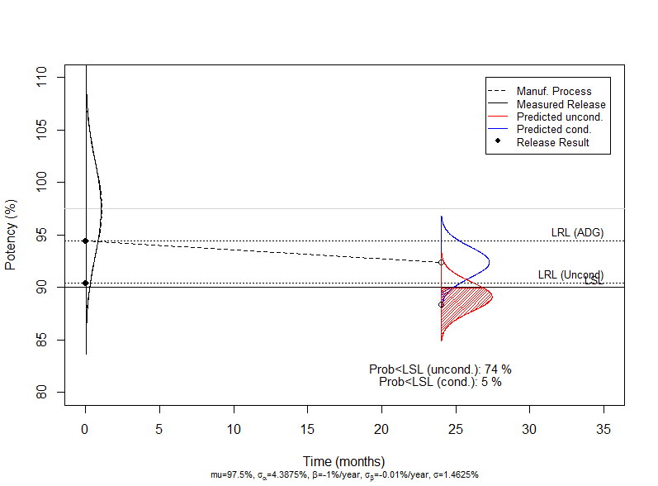
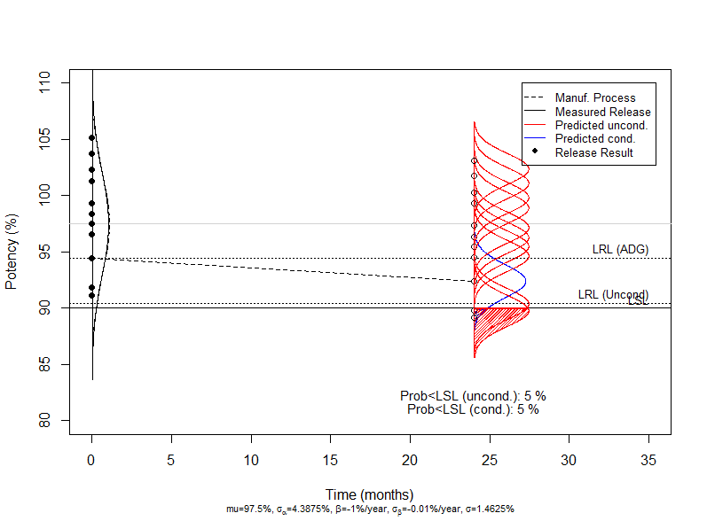
Risk controlled by the methods
The unconditional method controls the overall risk of OOS for the population.
The conditional method controls the risk of OOS for each single batch

Slide 29
The use of the two methods are quite different
Conditional (ADG) | Unconditional (Wei)
Each batch is evaluated based on the release result | Batches are evaluated based on the release result AND the assumption that the process is in statistical control
In principle the release limit alone protects us against OOS at stability. SPC of the manufacturing process is for preventive reaction and not a prerequisite for releasing a batch. | The assumption that the process is in statistical control is central and this should be verified by careful use of statistical control charts, short-term review of incidents etc. before releasing the batch
The higher the analytical uncertainty, the more conservative is the ADG approach – and the worse is the process capability | The higher the analytical uncertainty, the more critical is the assumption that the process is in control
Can be used to assess the risk for isolated batches | Cannot be used to evaluate isolated batches

Slide 30
Conclusions: Internal release limits
The frequentist (or conditional) method provides confidence for each single batch based on release data only. This may result in narrow internal release limits, for instance when analytical uncertainty is high.
The unconditional Bayesian principle provides much wider internal release limits, but at the price of specific assumptions:
The manufacturing process must be in statistical control with known mean and standard deviation
Only the overall of risk of OOS is controlled, not the OOS risk for each individual batch

