Slide 1
Leveraging omics data in drug development – get ready for the show
Weidong Zhang
Pfizer

Slide 2
Outline
Overview of omics technology
Application of omics in drug discovery
Case studies from pre-clinical to phase II/III

Slide 3
Omics provide paramount view of biological cascade
DNA
Genomics
(3x10⁹ nt)
RNA
Transcriptomics
(25k genes)
Protein
Proteomics
(>1000*)
Metabolite
Metabolomics
(~ 350 **)
* Depending on technology
** Depending on technology and tissue

Slide 4
Omics data are key to drug development
Global/Unbiased view of disease biology
Novel opportunities for assessment of pharmacology
Greatly enhance our understanding of disease etiology at molecular level
Opportunity to develop robust molecular biomarker for patient selection
Cost effective

Slide 5
Major technologies – genomics/transcriptomics
Information/Data
Level of prior evidence
qPCR
TLDA
Microarray
NGS
Gene expression
Gene expression
Gene Expression
Genotyping
Gene Expression
Gene fusion
Novel isoform
Genotyping
Epigenetics

Slide 6
Applications of omics technology in drug discovery
Preclinical
FIH/POM
Phase II
Phase III/IV
Target discovery
Pharmacology
Drug response
Drug response
Toxicology
Dose response
Dose response
Safety
Safety
Disease biomarker
Pharmacology

Slide 7
Statistical challenges in omics technology
Big data
Big in P
P >> N
Big in complexity
Data types
Dependency
Control of false discovery rate (FDR)
Large number of statistical testings
Testings are not independent
Model selection
Balance goodness-of-fit with parsimony
Interpretation
How to make sense of the findings?
How to report and communicate findings?
Which findings are actionable?

Slide 8
Applications of omics technology in drug discovery
Preclinical
FIH/POM
Phase II
Phase III/IV
Target discovery
Pharmacology
Drug response
Drug response
Toxicology
Dose response
Dose response
Safety
Safety
Disease biomarker
Pharmacology

Slide 9
Omics in preclinical for target discovery
Cardiovascular disease is a complex disease
Multiple risk factors including both genetics and environmental factors
Omics data from laboratory mouse model may provide a valuable resource
Mice and human share 95-98% of the genomes and get the most of the same diseases
Tissue from mice are easy to access for data generation
Outbred mice can be great resource to understand CVD
290 NMRI outbred mice
Phenotypes
Albumin Creatinine Ratio (ACR)
High-density lipoprotein (HDL)
Cholesterol (CHL)
Glucose (GLU)
Triglyceride (TG)
Objective
To detect quantitative trait locus (QTL) associated with phenotypes

Slide 10
Genotypes
Affymetrix® Mouse Diversity Genotyping Array
581,672 SNPs
244,840 polymorphic SNPs
103,872 polymorphic SNPs kept
MAF > 0.02
HWE chi-square < 20
% missing < 40%
Missing genotypes imputed by fastPhase (Scheet and Stephens, 2006)

Slide 11
Single-locus genome scan
Additive & Dominance model
ANOVA test
Additive model
Linear trend test
Efficient Mixed-Model Association (EMMA) (Kang et al, 2008)
y = Xβ + Zu + e
where y = 288 x 1 vector of phenotypes;
β = additive fixed effect of a SNP;
u = random effects from individual genetic background;
e = residuals;
y ~ MVN(Xβ, ∑)
∑ = ZKZ’σ_{g} + I_{e} σ _{e}

Slide 12
Genome-wide threshold
Permutation (Churchill and Dorge, 1994)
Simulation
y' ~ MVN(µ, K σ_{g} + I_{e}σ_{e})
Replace the simulated values with observed values in a manner that preserved the rank order of the simulated values
Repeat for 100 samples

Slide 13
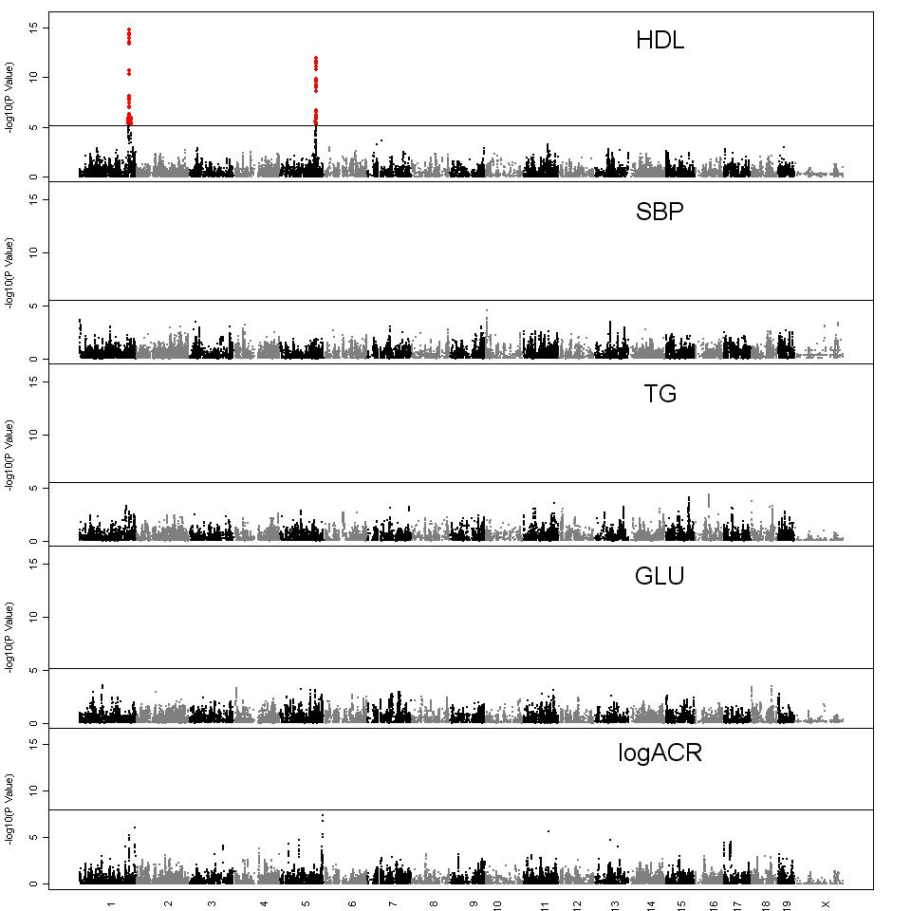
Genome scan
Zhang et al, 2012

Slide 14
Multilocus models
Forward stepwise regression with resampling
For each phenotype, bootstrap the 288 animals
Repeat 100 bootstrap samples
Resample model inclusion probabilities (RMIP)
RMIP_{m}= ∑ I_{rm}/R
I_{rm} = 1 if at least one SNP within ± 2Mb of SNP m was included in the model of sample r
= 0 otherwise
Valdar et al , 2009

Slide 15
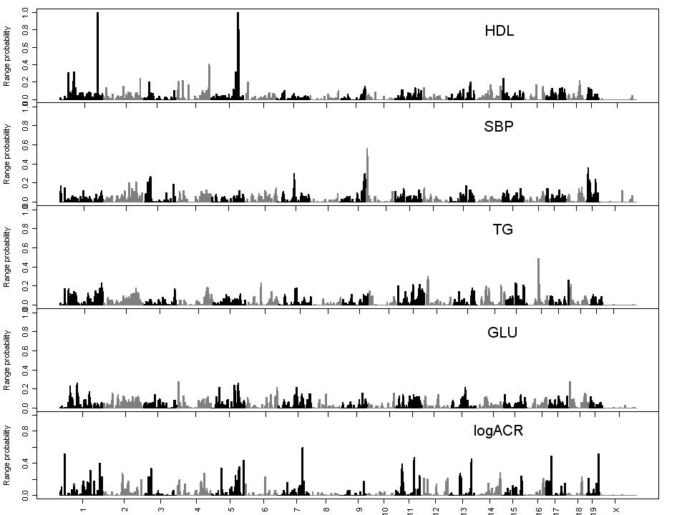
Genome-wide RMIP
Zhang et al, 2012

Slide 16
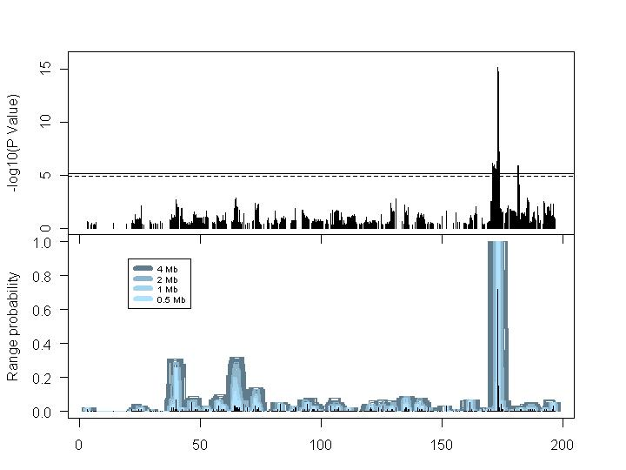
RMIP for HDL on Chr1
Zhang et al, 2012

Slide 17
Precision of QTL location
Precision of QTL mapping in outbred mice
Estimate precision by simulations
Randomly pick a SNP R from genome
Record location of SNP R
Simulate phenotype using the expected phenotype with the same correlation matrix among animals as for the QTL
Y ~ MVN(µ, ∑)
Where µ defines QTL effect
∑ = Kinship*σ_{g} + Ie* σ_{e}
Repeat for 1000 times

Slide 18
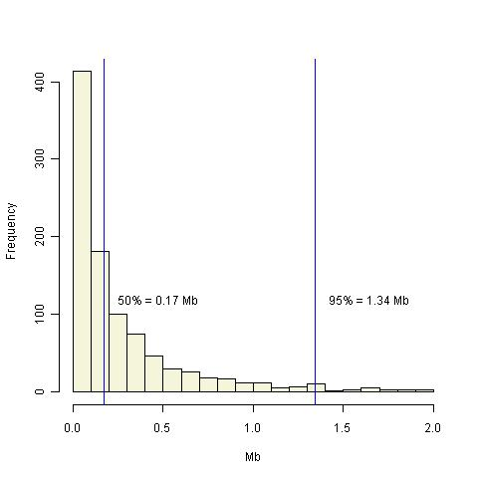
Precision plot

Slide 19
Applications of omics technology in drug discovery
Preclinical
FIH/POM
Phase II
Phase III/IV
Target discovery
Pharmacology
Drug response
Drug response
Toxicology
Dose response
Dose response
Safety
Safety
Disease biomarker
Pharmacology

Slide 20
Proof of Mechanism
POC
Success
Pillar 1
Pillar 2
Pillar 3
Adequate
Exposure
Adequate
Binding
Adequate
Pharm. Eff
POM Success = Totality of Data
Literature
Preclinical
Clinical
Notes:
Proximal mechanism biomarker with clear quantitative linkage to target activity
High quantifiability
High dynamic range
High sensitivity, specificity and reproducibility
Reasonable inter- and intra subject variability
Less invasive and easily accessible

Slide 21
Biomarkers are essential to POM success
Single biomarker
Multiple biomarkers
Global biomarkers (Omics)
Transcriptomics
Proteomics
Metabolomics

Slide 22
Transcriptomics biomarker may provide new opportunities for POM success
Proximal measurement of target activities
Mature and affordable technologies
Easy to access
High repeatability and reproducibility

Slide 23
Key questions
How do we select genes?
How do we use multiple genes to make a decision?
What are the metrics?

Slide 24
How do we select genes?
Transcriptome
Robustness
Literature/Prior data
30 IFN genes
Variability/Effect
FDR protected statistical testing
DE IFN genes
1
30

Slide 25
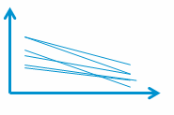
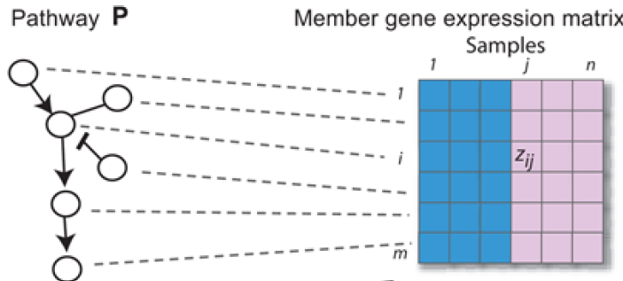
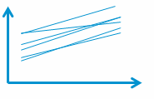
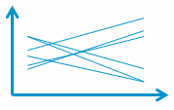
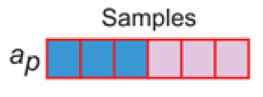
Metrics: selecting and summarizing multiple genes
?
Lee, 2008
P
Method | Pros | Cons | Application
Averaging | High interpretability; Easy comparison btw programs | Average gene effect; results may be driven by highly variable genes | Pharmacology quantification: Rontalizumab, Sifalimumab, Anifrolumab, MK-0752
Z score | Results may be robust to highly variable genes | Modest interpretability; | Clustering/Classification
Principal component/LDA/Eigengene | Weighted average of genes | Low interpretability; Loss of information | Clustering/Classification

Slide 26
Applications of omics technology in drug discovery
Preclinical
FIH/POM
Phase II
Phase III/IV
Target discovery
Pharmacology
Drug response
Drug response
Toxicology
Dose response
Dose response
Safety
Safety
Disease biomarker
Pharmacology

Slide 27
Understand drug response and safety with genomics data
Understanding biological response to drugs is fundamental to evaluation of drug safety
Genomics data may provide insights to understand the biological process underlying the toxicity of the drugs

Slide 28
Herpes Zoster (HZ) in Tofacitinib PII/III studies
Increased HZ rates were observed with tofacitinib, particularly among patients within Asia
Psoriasis
Japanese population 24/100 pt yrs
None-Asian: 2.3 cases /100 pt yrs
RA
Asian population 7.7/100 pt yrs RA
None-Asian population 4.2 cases /100 pt yrs
Genetic factors contributing to the risk of tofacitinib related HZ may
Reveal the mechanisms of latent varicella-zoster virus (VZV) infection in Tofacitinib
Facilitate biomarker discovery predictive of tofacitinib related HZ
Support management of patients with infectious risk
Facilitate development of novel differentiated selective JAK inhibitors

Slide 29
Genetic Association Study Design
Subjects:
DNA samples from 5605 subjects in RA, PsO phase II, III and long term extension tofacitinib studies
Genetic variants
Illumina Human OmniExpress + Exome genome-wide array (~960k markers total)
Endpoints
HZ cases vs. controls
Time to HZ events
Covariates Adjusted
Age, Baseline absolute lymph count, Genetic population stratification, and Concomitant methotrexate use (RA only)
Notes:
37 million markers, remove by QC

Slide 30
Data preprocessing and modeling
QC & Imputation (Donnelly and Marchini, 2009)
Modeling
HZ incidence
Firth logistic regression (Firth, 1993)
Time to HZ event:
Cox regression (Cox, 1972)
FDR control: genome wide sig. threshold: p = 5e-8 (Panagiotou et al., 2011; Pe’er et al, 2008)

Slide 31
Overview of Genome-wide Association with HZ
HZ Case Control
ACSF3
CD83
*
Time to HZ
IL17RB
CD83
GPR141
TOX3
ACSF3
* Genome-wide significance at 5×10⁻⁸

Slide 32
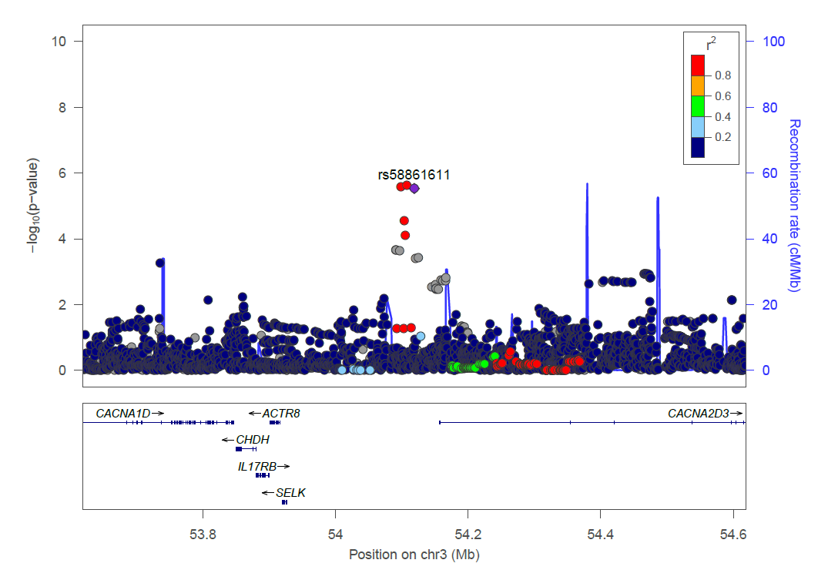
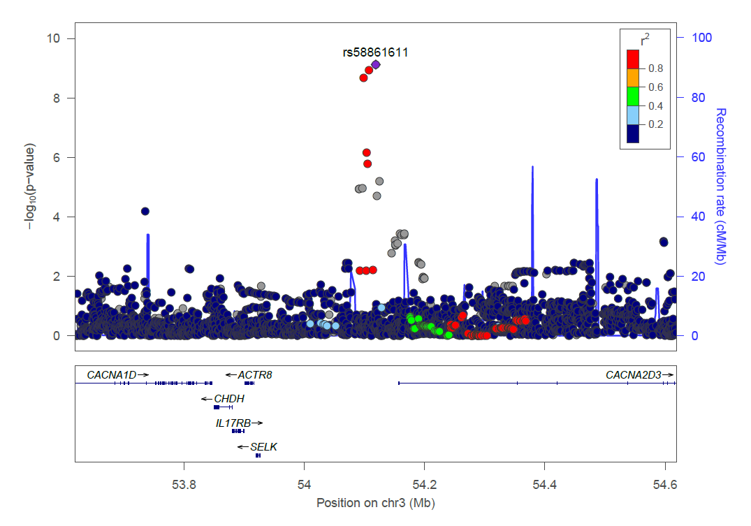
Rs58861611 Near IL17RB Associated with HZ Suggesting Th2 vs Th1 Mechanisms
HZ Case Control
Time to HZ
IL17RB encodes a cytokine receptor for IL17B and IL17E (IL25)— key factors in Th2 immunity. Variants may increase the Th2:Th1 ratio, thus leading to increased risk of HZ in tofacitinib-treated patients.
Genetic amplification of IL-25, the ligand for IL-17RB, leads to recurrence of varicella (Genes Immun, 2011;12:663-666)
HZ=herpes zoster; iNKT=invariant natural killer T; IL=interleukin; PsO=psoriasis; RA=rheumatoid arthritis; RB=receptor B; Th=T-helper.
Nan Bing
Notes:
Vaccine-associated varicella and rubella infections in severe combined immunodeficiency with isolated CD4 lymphocytopenia and mutations inIL7Rdetected by tandem whole exome sequencing and chromosomal microarray D. K. Bayer, C. A. Martinez, H. S. Sorte, L. R. Forbes, G. J. Demmler-Harrison, I. C. Hanson, N. M. Pearson, L. M. Noroski, S. R. Zaki, W. J. Bellini, M. S. Leduc, Y. Yang, C. M. Eng, A. Patel, O. K. Rodningen, D. M. Muzny, R. A. Gibbs, I. M. Campbell, C. A. Shaw, M. W. Baker, V. Zhang, J. R. Lupski, J. S. Orange, F. O. Seeborg, and A. Stray-Pedersen Clinical & Experimental Immunology (2014) 178: 459

Slide 33
Proteomics may add additional values to drug development
Omics | Technologies | Num of Analytes measured | Pros | Cons
Proteomics | OLINK | 450 | Homogeneous Low sample volume (1 uL). Quantitation is comparable to gold standard | Platform is still being developed and panels are changing, internal controls for multi-study comparison not yet established
 | Shot gun MASS Spec. | 1000s | Best used to ID proteins in cells | Does not have sufficient dynamic range for serum/plasma. Not sensitive to detect <5 ng/ml proteins
 | MRM Mass spec | ~10-20 | Quantitative, using spiked peptide | Not practical for high multiplexing
 | Myriad RBM (combination of Luminex and Quanterix Simoa) | 350 | Best practice for internal controls and standards which limit batch variability (only platform which different studies can be compared) | High sample volume (1- 1.5 mL) and expense for measuring all 319 proteins. Can choose subsets for better value

Slide 34
Summary
Genomics data have proved to be powerful tools in target discovery and understanding of safety profile of patients in clinical trials
Transcriptomics may provide novel insights to understand pharmacological activities in early clinical trials
Proteomics may provide additional value in drug discovery

Slide 35
Acknowledgements
Pfizer
Huanyu Zhou
Nan Bing
Baohong Zhang
The Jackson Laboratory
Ron Korstanje
Hyuna Yang
Tim Stearns
Gary Churchill
Novartis
Keith DiPetrillo
University of North Carolina
William Valdar

